Slide 1

Exploratory Analysis among Call Year, NRCS Forecasts, SWE, and EDDI

Slide 2
First, let’s take a look at correlations among variables across all available years for all districts.

Slide 3
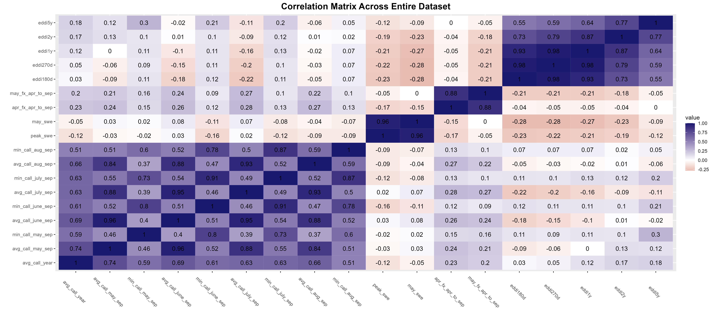
Predictors
Response Variables: Call Year

Slide 4
Next, let’s take a look at correlations among variables across all available years for a few example districts.

Slide 5
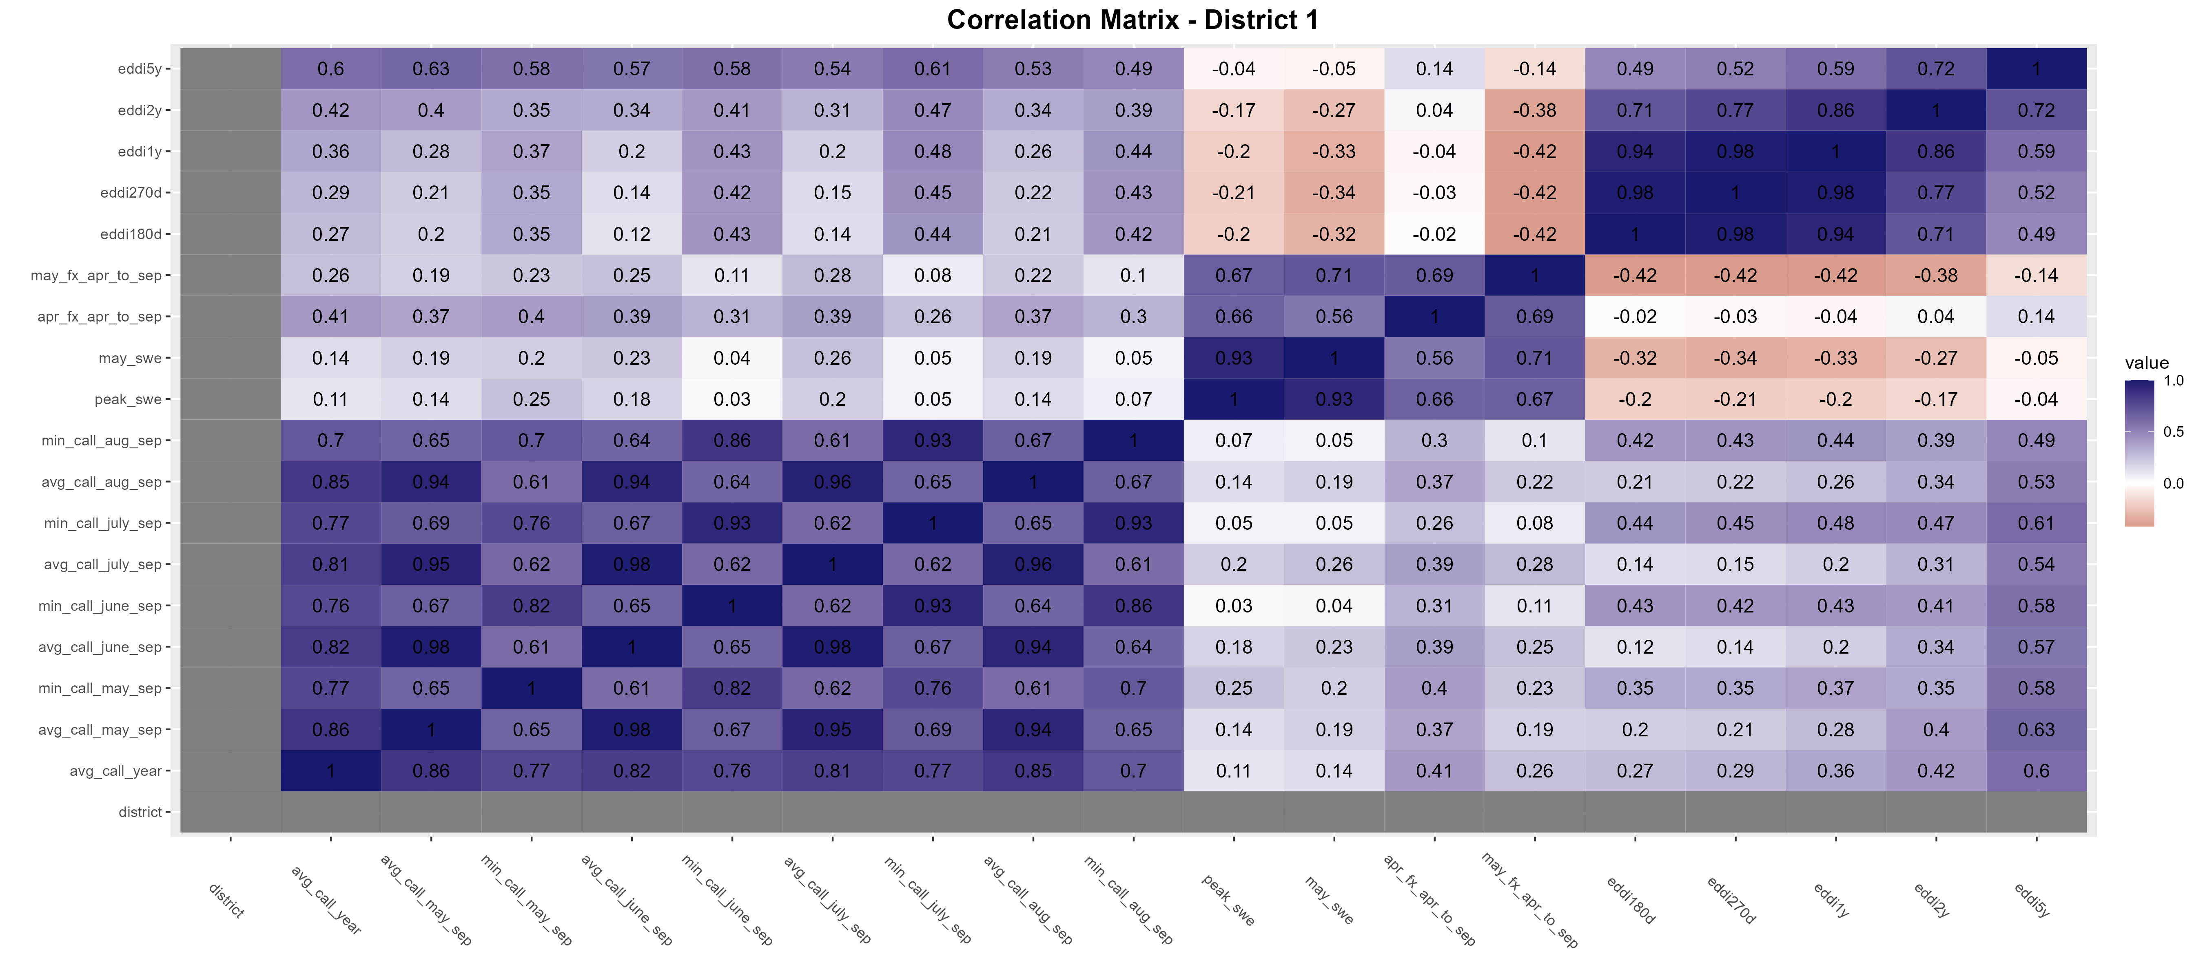
District 1 shows best correlations compared to other districts

Slide 6
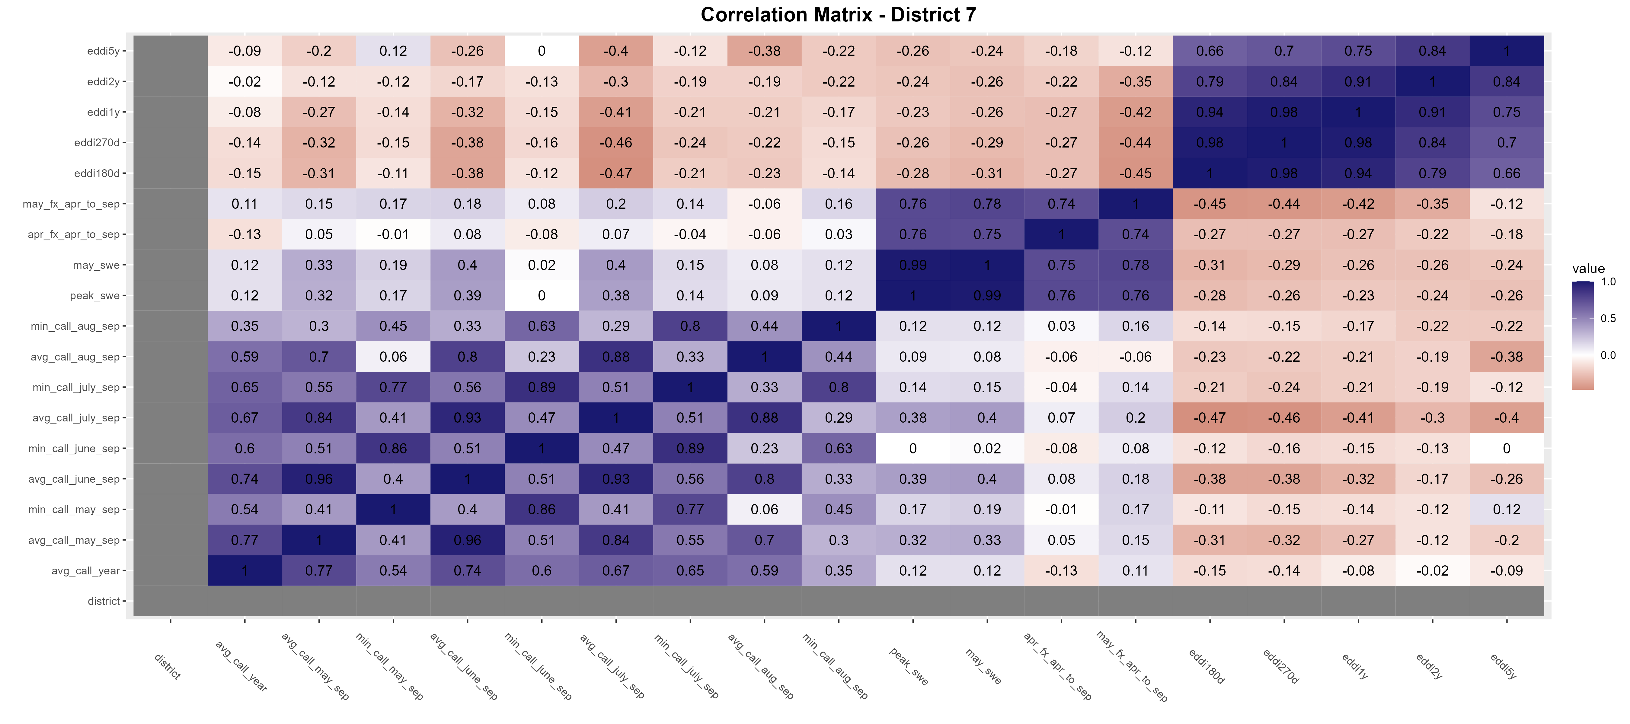
District 7 presents worse correlations compared to other districts

Slide 7
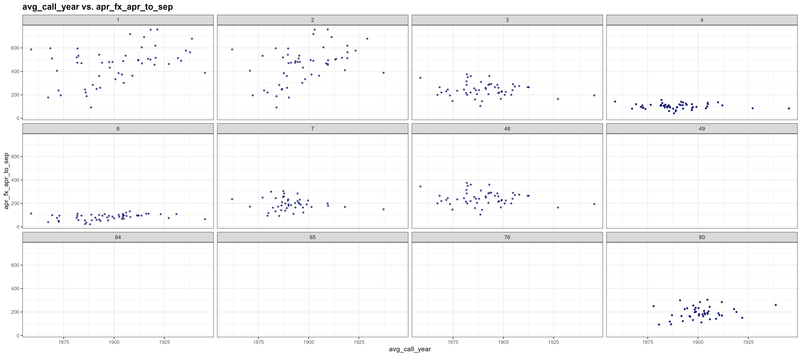
Scatter Plots (by District) of Average Call Year vs April-September NRCS Forecast Volumes (KAF) for April 1 Forecast/Publication Date

Slide 8
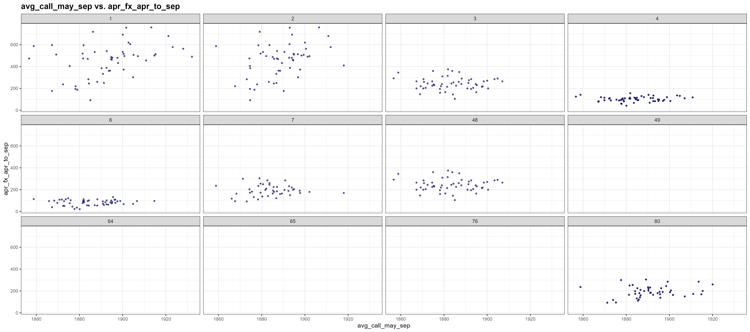
Scatter Plots of Average Call Year during May-Sep vs April-September NRCS Forecast Volumes (KAF) for April 1 Forecast/Publication Date

Slide 9
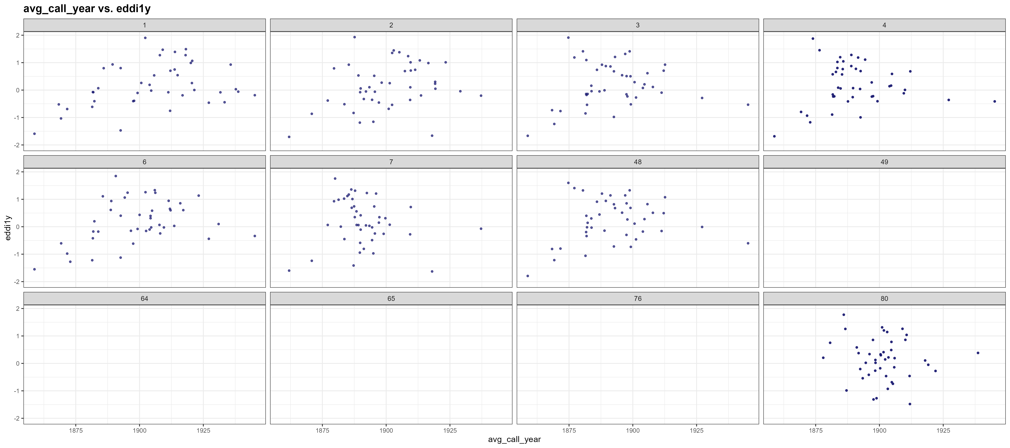
Scatter Plots of Average Call Year vs EDDI (1y)

Slide 10
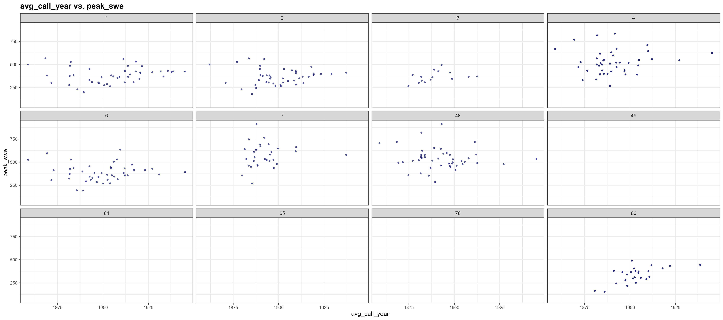
Scatter Plots of Average Call Year vs Peak SWE

Slide 11
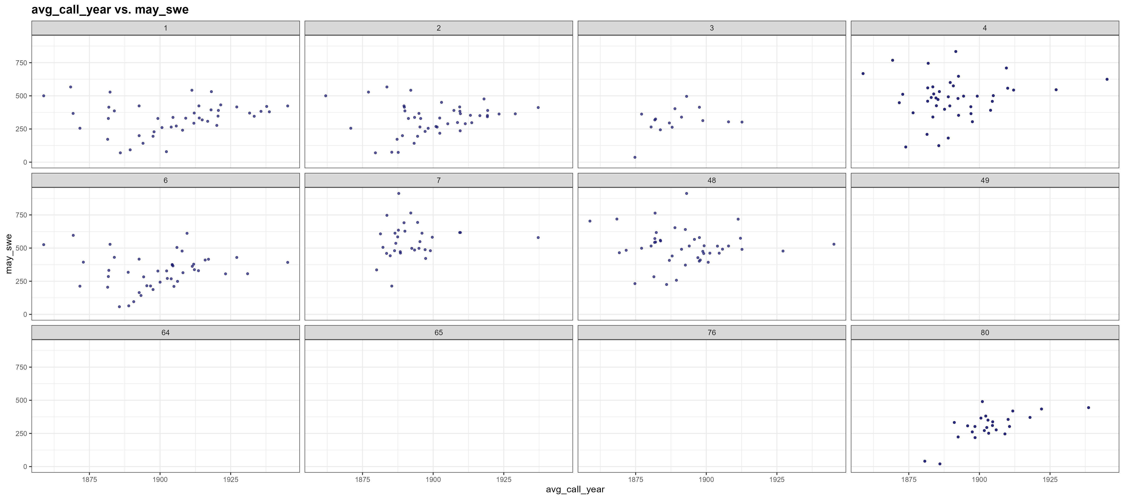
Scatter Plots of Average Call Year vs May 1 SWE

Slide 12
Due to weak correlations, we narrowed down the period of interest to drytail years and extracted more detailed patterns when streamflow is low.
We looked at periods where observed average streamflow across all stations in a district are in the:
Lower tercile (<= 33rd percentile flow)
Lower half (<= 50th percentile flow)

Slide 13
Lower Tercile

Slide 14
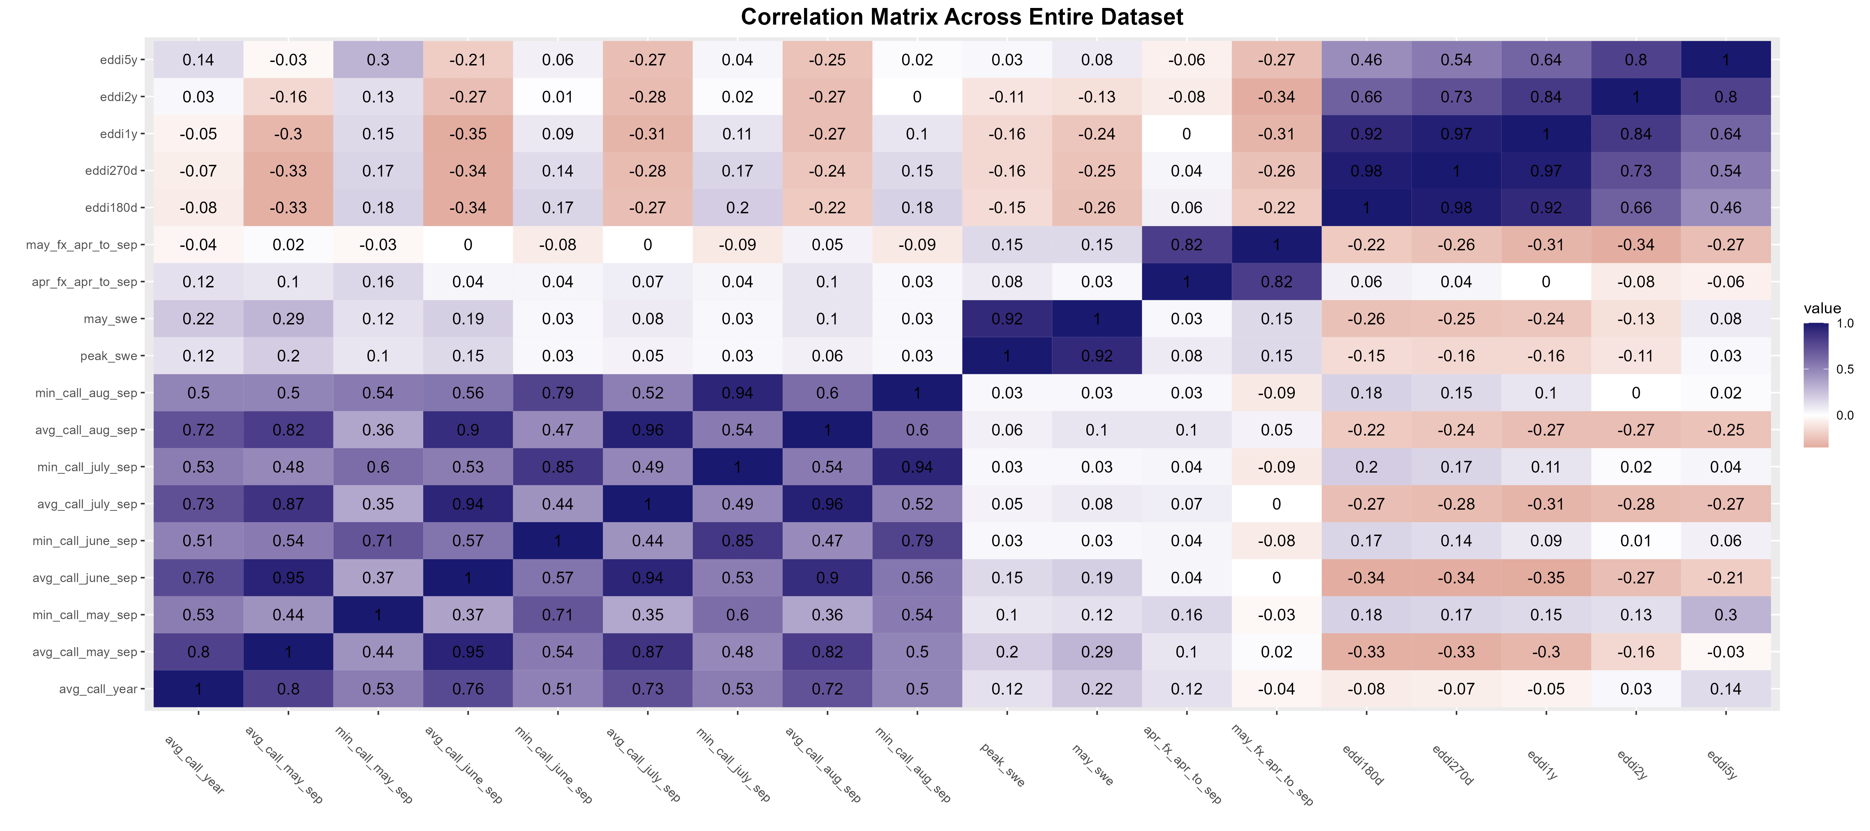
Predictors
Response Variables: Call Year

Slide 15
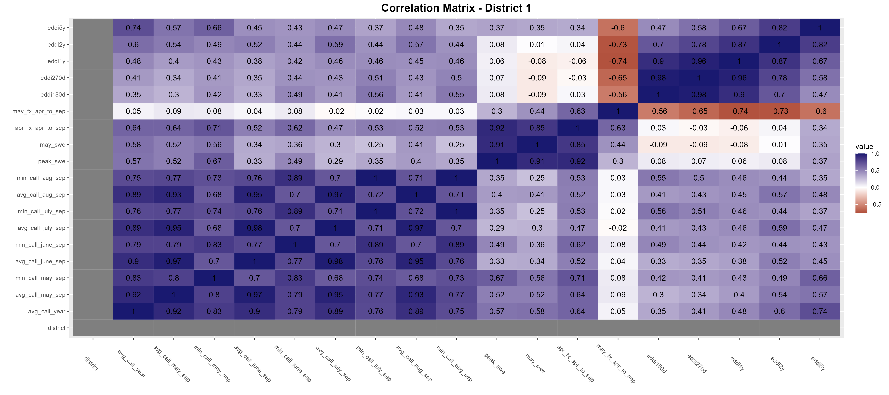
Significant correlations among EDDI5y, April forecast, SWE and avg call year, min call year (may-sep)

Slide 16
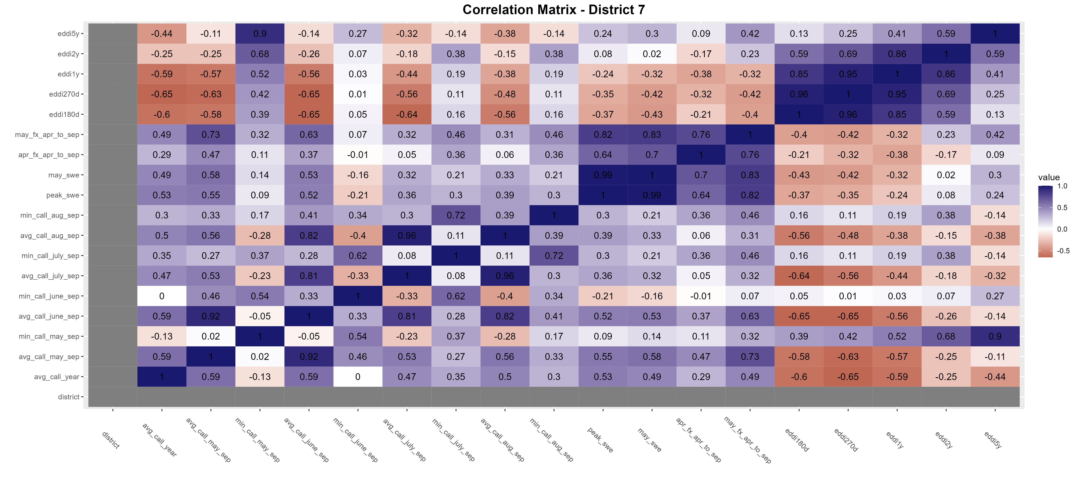
Significant correlations between EDDI5y and min call year (may-sep), May forecast and avg call year (may-sep), but poor correlations among others.

Slide 17
The best unique predictors for each district (for lower tercile drytail years)
District | Best response var | Best predictor(s)
1 | Avg call year | Eddi5y, apr_fx_apr_to_sep
2 | Avg call year | apr_fx_apr_to_sep, may_swe
3 | Avg call may-sep | Peak_swe, may_swe
4 | Avg call may-sep | May_fx_apr_to_sep
5 | Min call may-sep | Apr_fx_apr_to_sep, peak_swe
6 | Avg call year | apr_fx_apr_to_sep, may_swe
7 | Min call may-sep Avg call may-sep | Eddi5y may_fx_apr_to_sep
8 | Avg call may-sep Avg call june-sep | may_fx_apr_to_sep may_swe, peak_swe
9 | Avg call year | May_swe, peak_swe, may_fx_apr_to_sep
23 | Avg call year | may_fx_apr_to_sep, may_swe
48 | Min call june-sep | Eddi180d
64 | Avg call year | Eddi5y
80 | Avg call year | May_swe, may_fx_apr_to_sep
(grayed out where best predictors had below 0.5 correlation)

Slide 18
Lower half (using median)

Slide 19
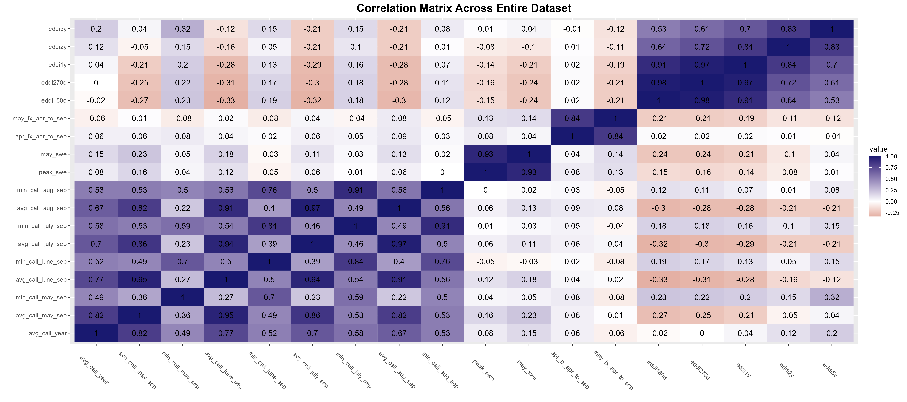
Predictors
Response Variables: Call Year

Slide 20
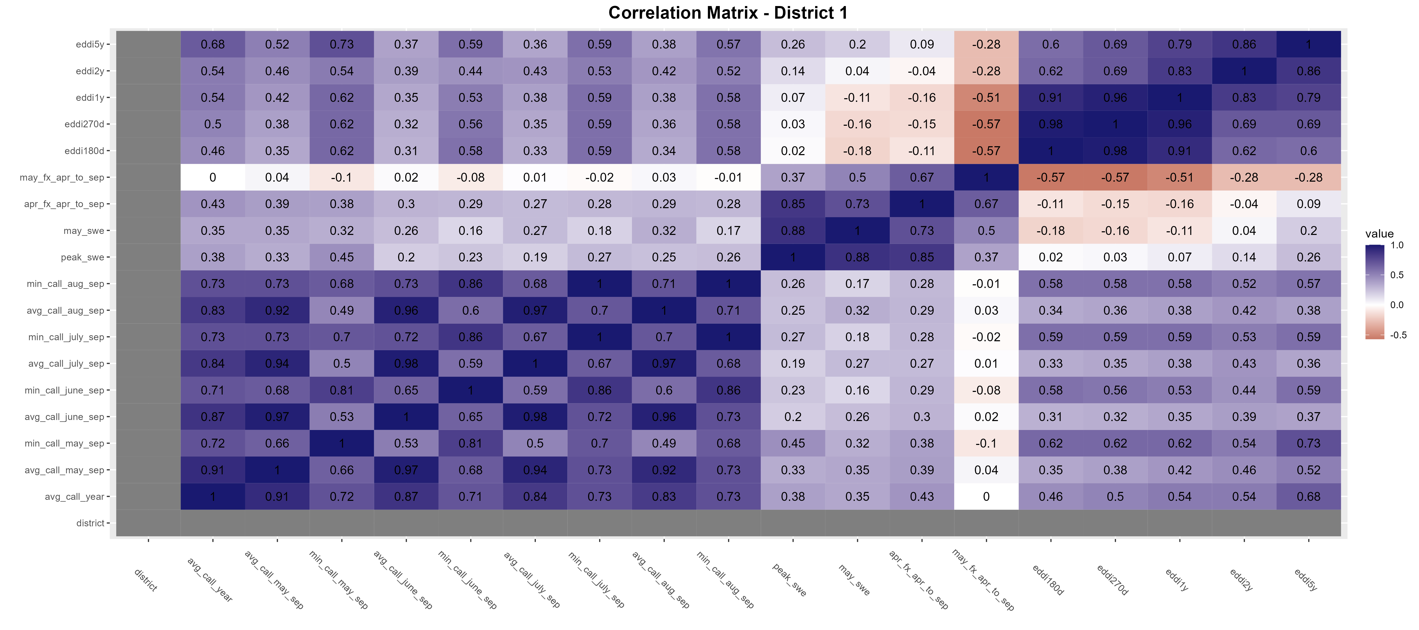
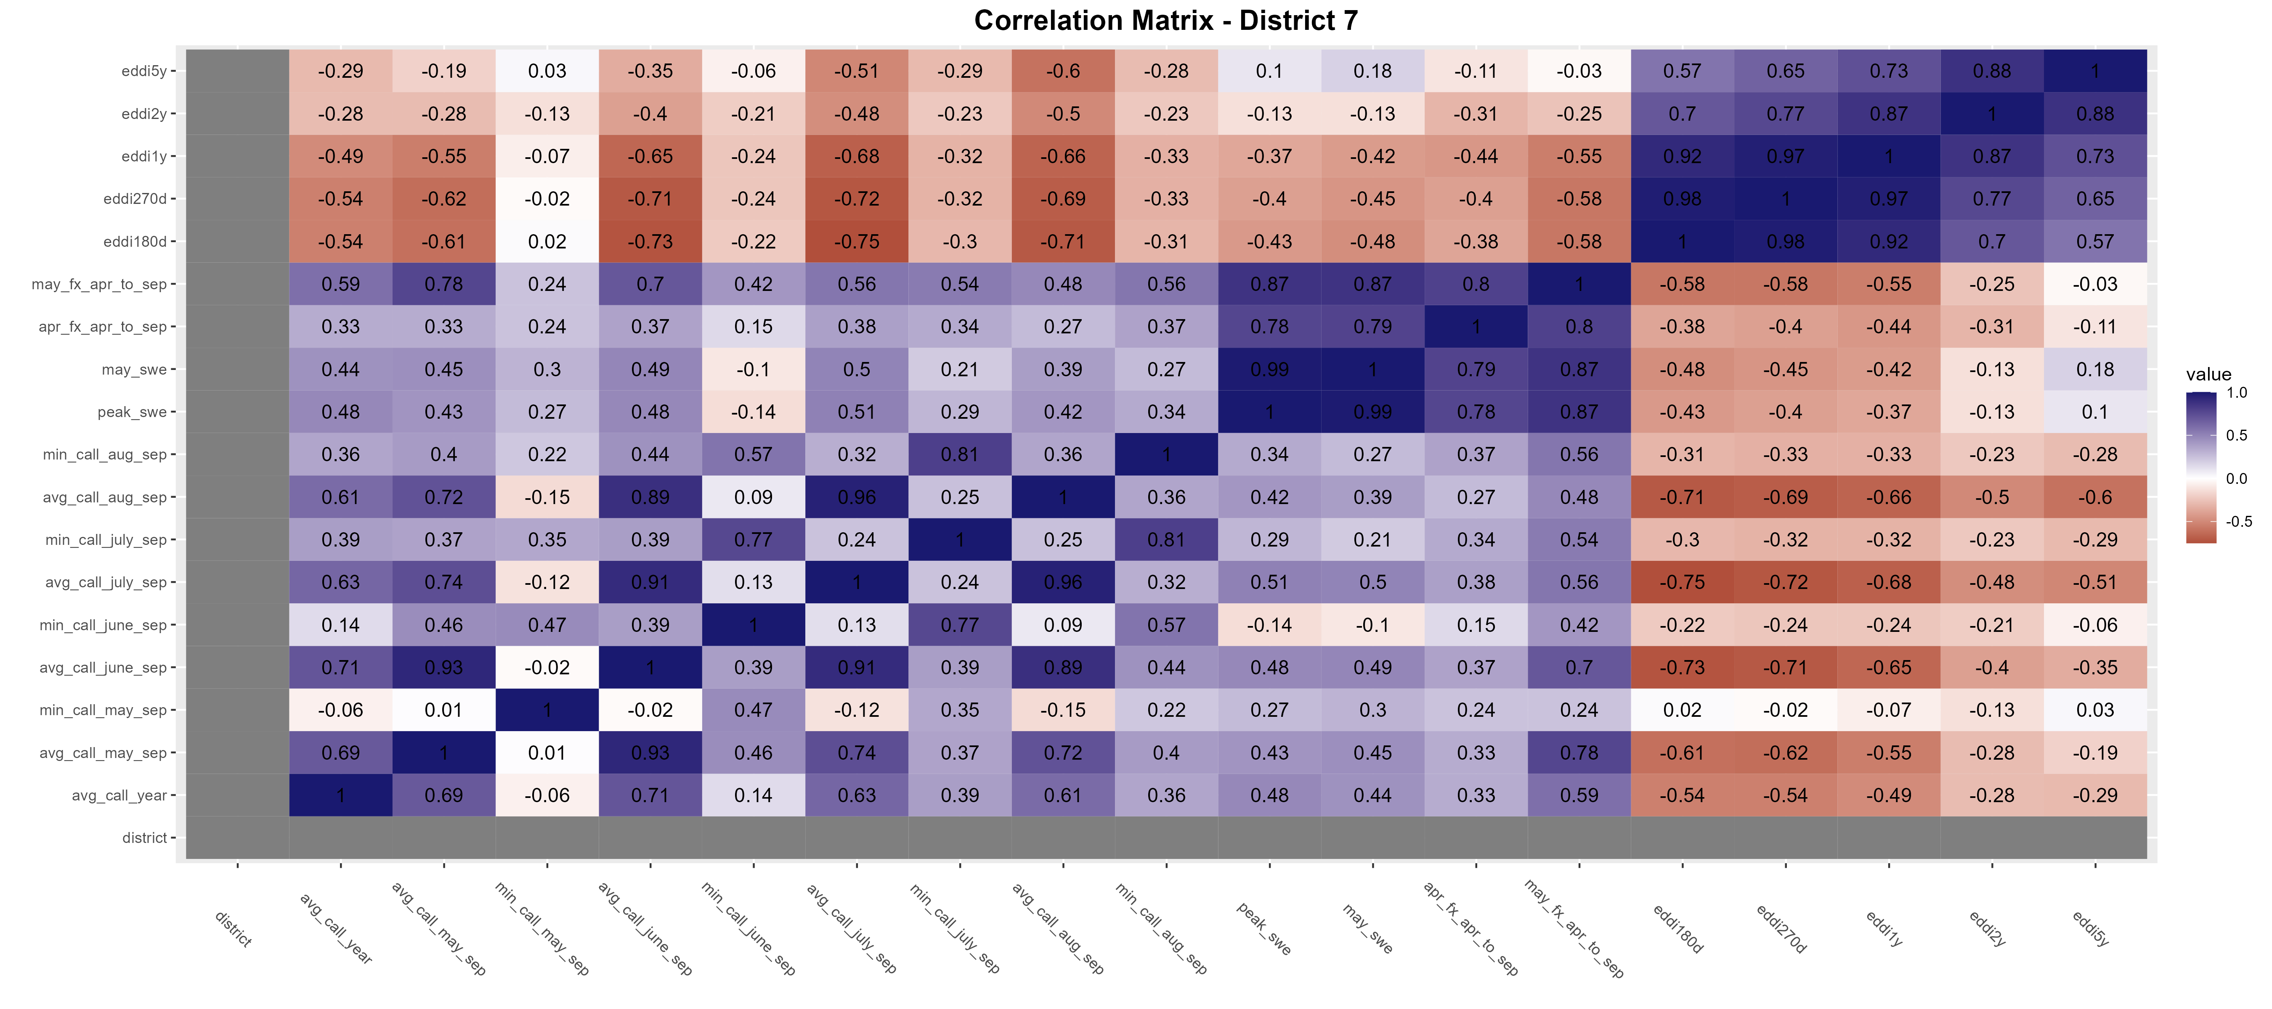
Correlation Matrices by District – Districts 1 and 7 as examples

Slide 21
The best unique predictors for each district (for lower half drytail years)
District | Best response var | Best predictor(s)
1 | Min call may-sep Avg call year | Eddi5y Eddi5y
2 | Avg call year | Apr_fx_apr_to_sep, eddi5y
3 | Avg call may-sep | May_swe, peak_swe
4 | Avg call may-sep | May_swe
5 | Min call may-sep | Peak_swe, eddi5yr, apr_fx_apr_to_sep
6 | Avg call year | Apr_fx_apr_to_sep
7 | Avg call may-sep | May_fx_apr_to_sep
8 | Avg call jun-sep Avg call may-sep | May_swe, peak_swe may_fx_apr_to_sep
9 | Avg call year | May_swe, peak_swe, may_fx_apr_to_sep
23 | Avg call year | May_fx_apr_to_sep
48 | Min call june-sep | Eddi180d
64 | Avg call year | Eddi5y
80 | Avg call may-sep | May_fx_apr_to_sep
(grayed out where best predictors had below 0.5 correlation)

Slide 22
Summary

Slide 23
Findings
Looking at the entire dataset (across all districts), narrowing down to drier years worsens the overall correlation.
However, looking at each district, drier years can worsen and improve correlations among specific pairings of response and predictor variables for each district.

Slide 24
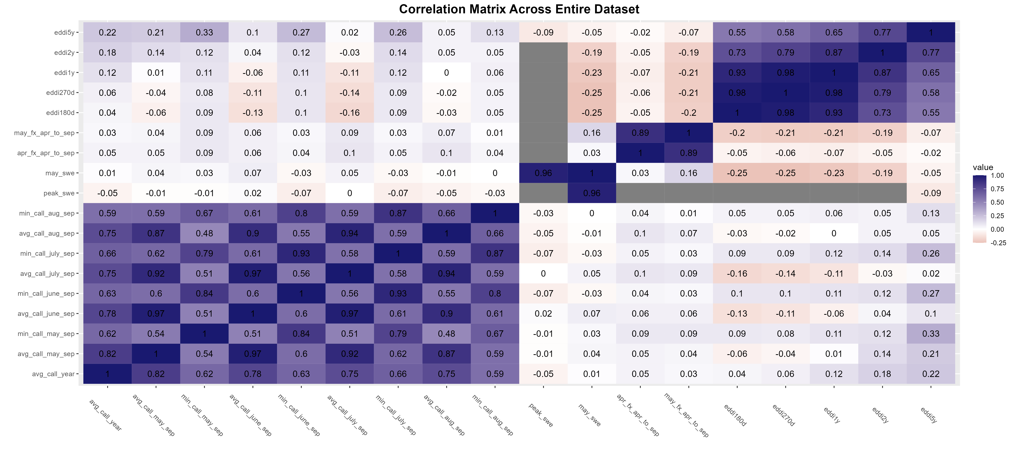
Entire Dataset Comparison: All call years

Slide 25
Entire Dataset Comparison: <=50% dry years

Slide 26
Entire Dataset Comparison: <=33% dry years

Slide 27
Findings
Performance is better analyzing each district individually (e.g., District 6-Boulder Creek) rather than using the entire South Platte Basin (Division 1)
Unique regression models with unique pairings of predictor and response variables needed for each SP district
Specific correlations increased when using Dry Years (<median flow) and Driest Years (<33% flow) rather than using all years
i.e., May_swe vs avg_call_year, Apr_Fx_Apr_to_Sep vs avg_call_year for District 2

Slide 28
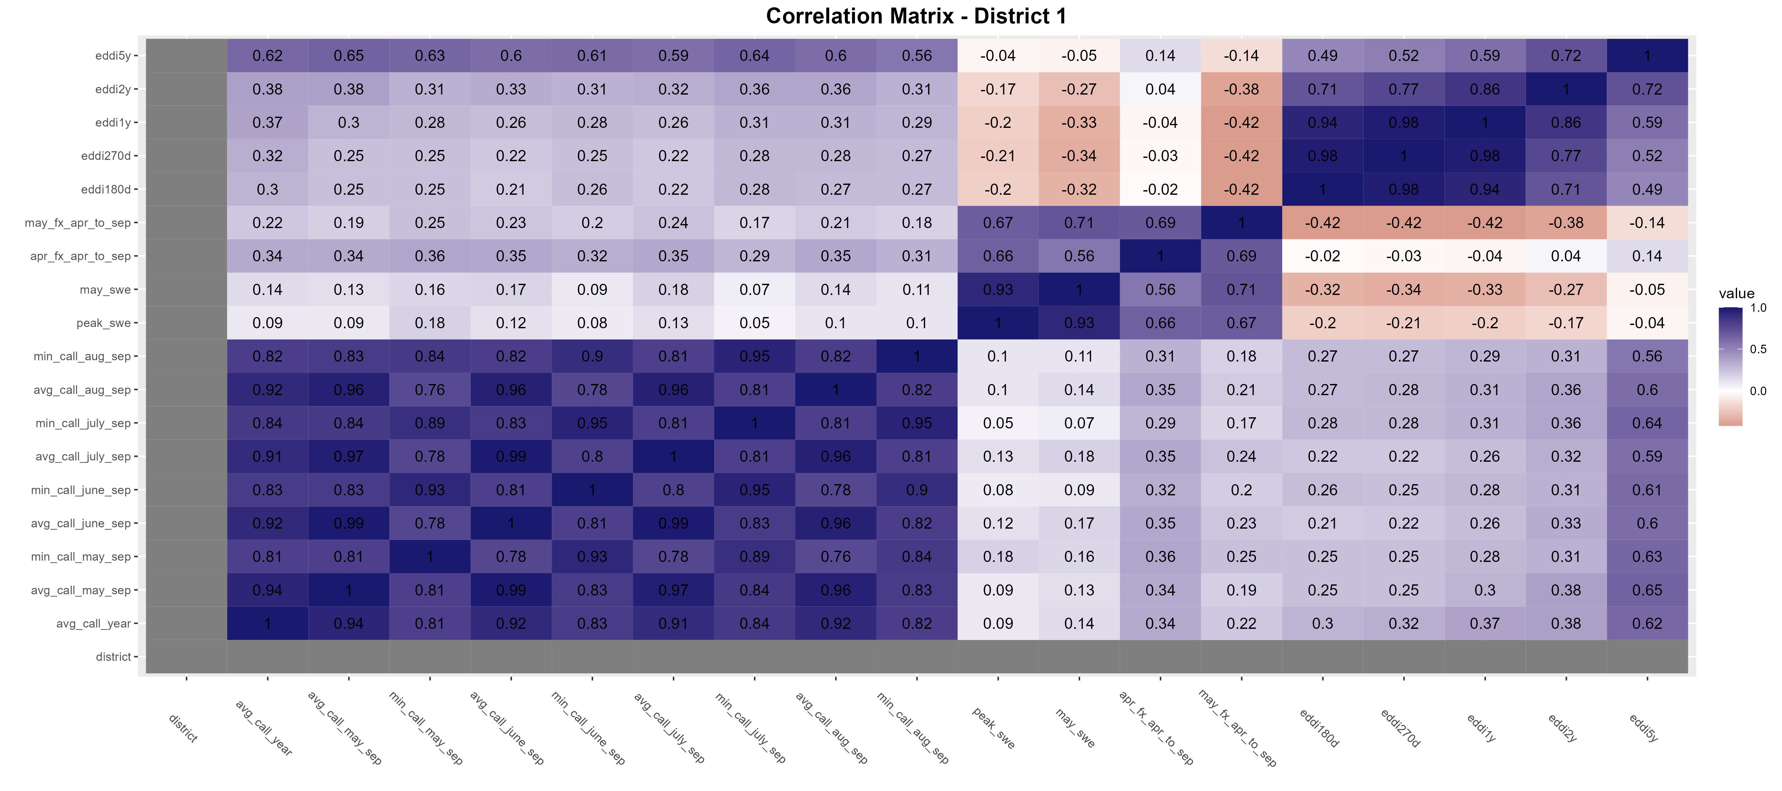
District 1 = South Platte - Denver Gage to Greeley
Dataset with all available years (dry and wet)

Slide 29

District 1 = South Platte - Denver Gage to Greeley
<=50th percentile flow
Best pairing: Eddi180d vs min_call_may_sep

Slide 30

District 1 = South Platte - Denver Gage to Greeley
<=33rd percentile flow
Best pairing: April NRCS forecast vs avg_call_year

Slide 31
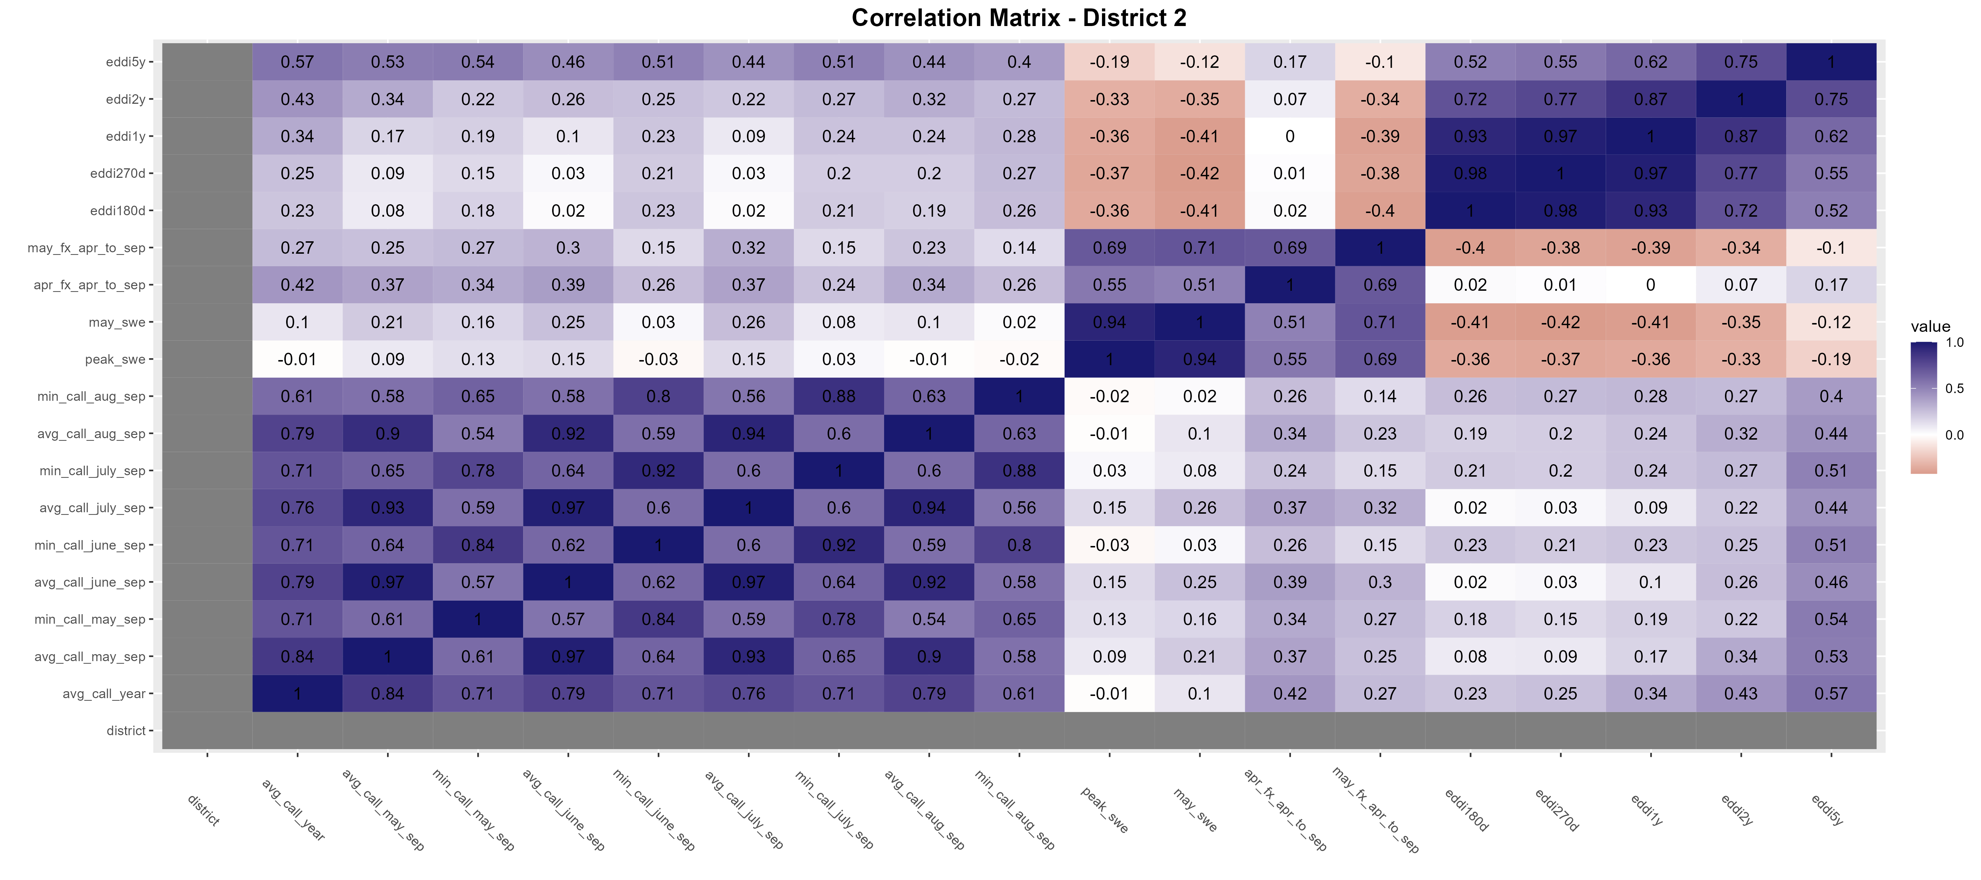
District 2
Dataset with all available years (dry and wet)

Slide 32
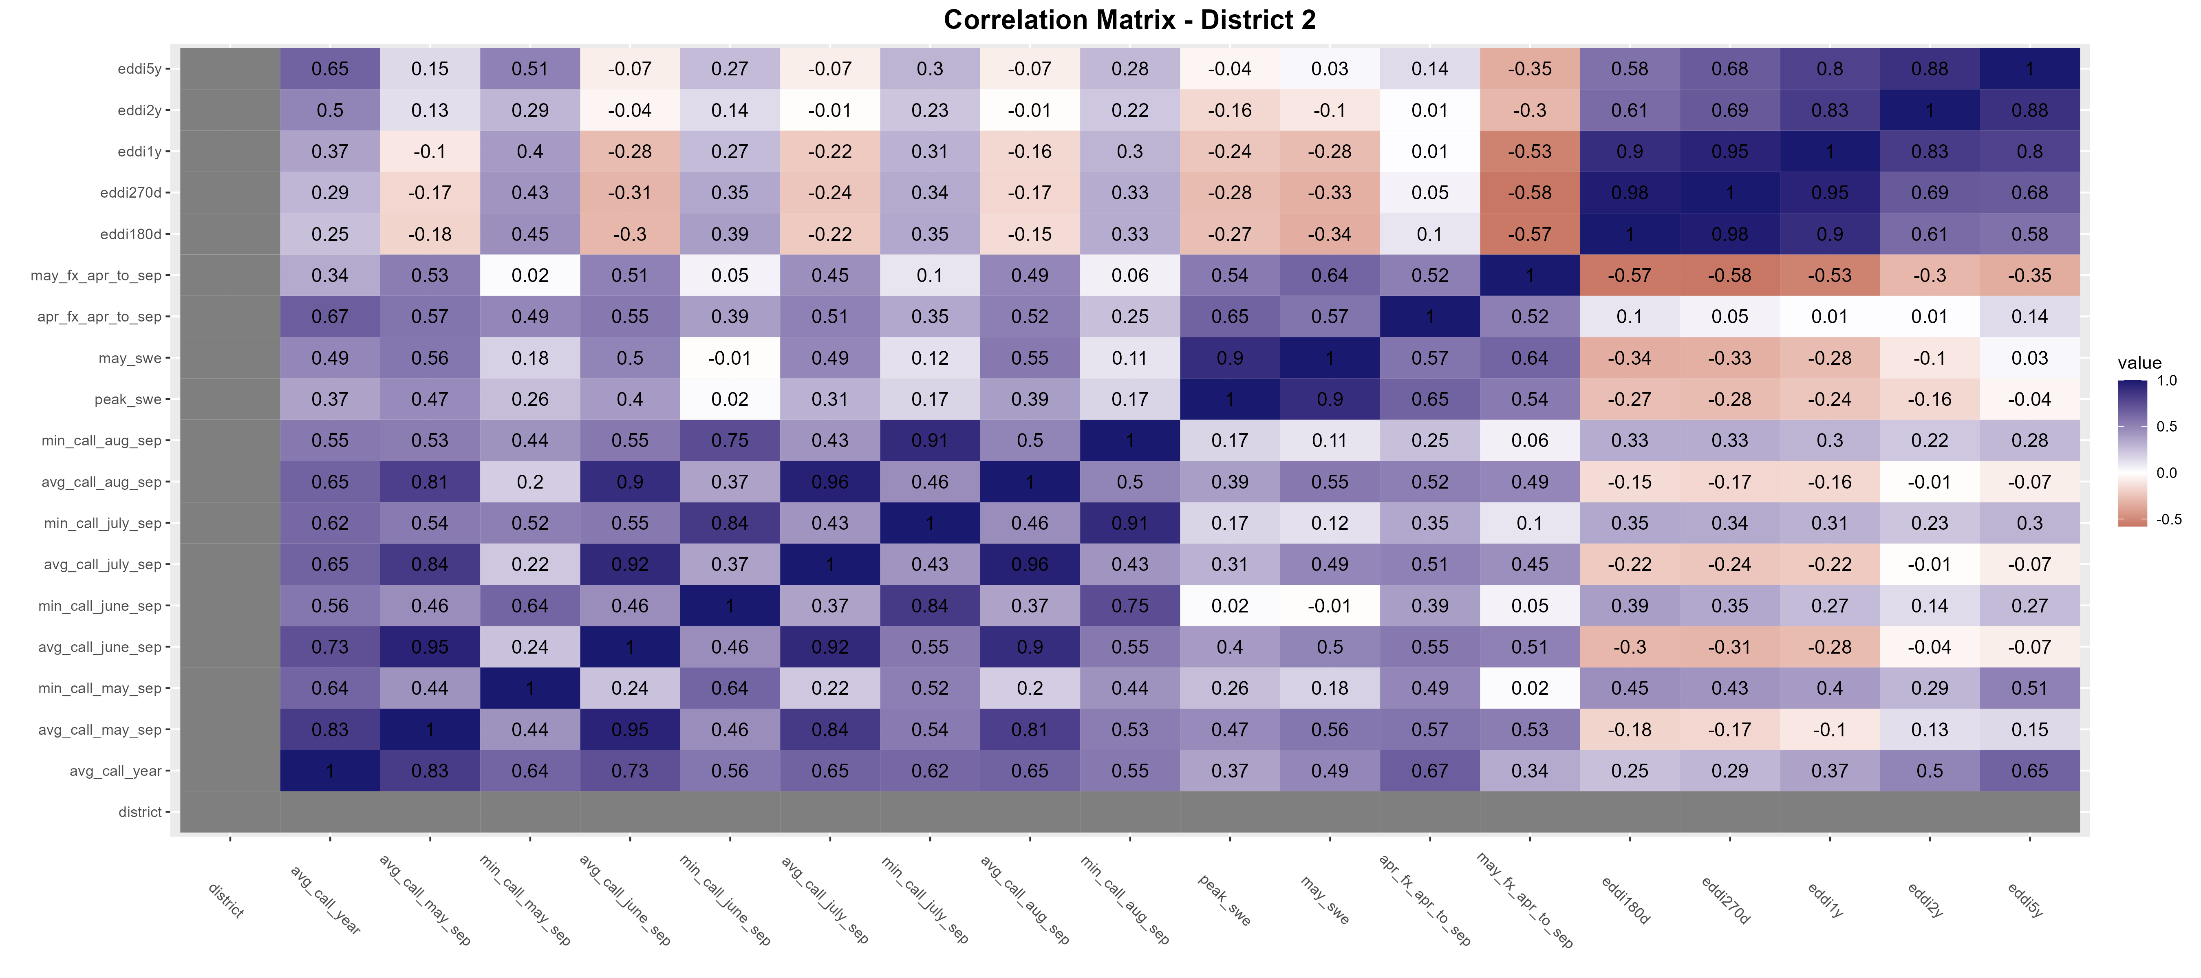
District 2
<=50th percentile flow

Slide 33
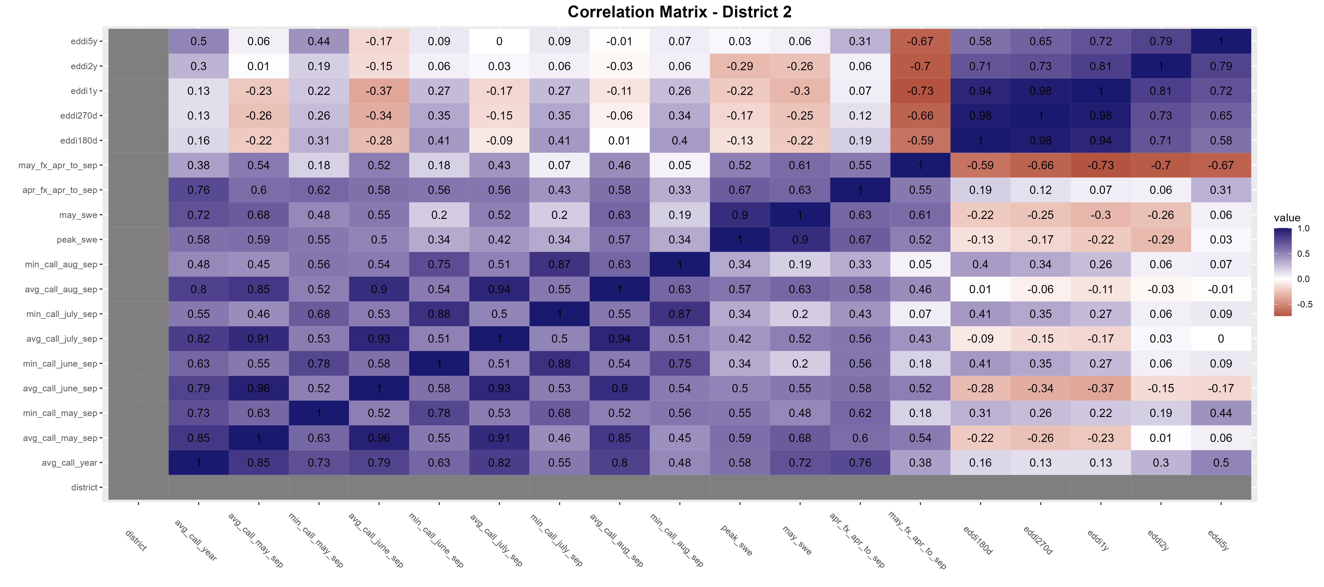
District 2
<=33rd percentile flow
Best pairing: April NRCS forecast vs avg_call_year

Slide 34
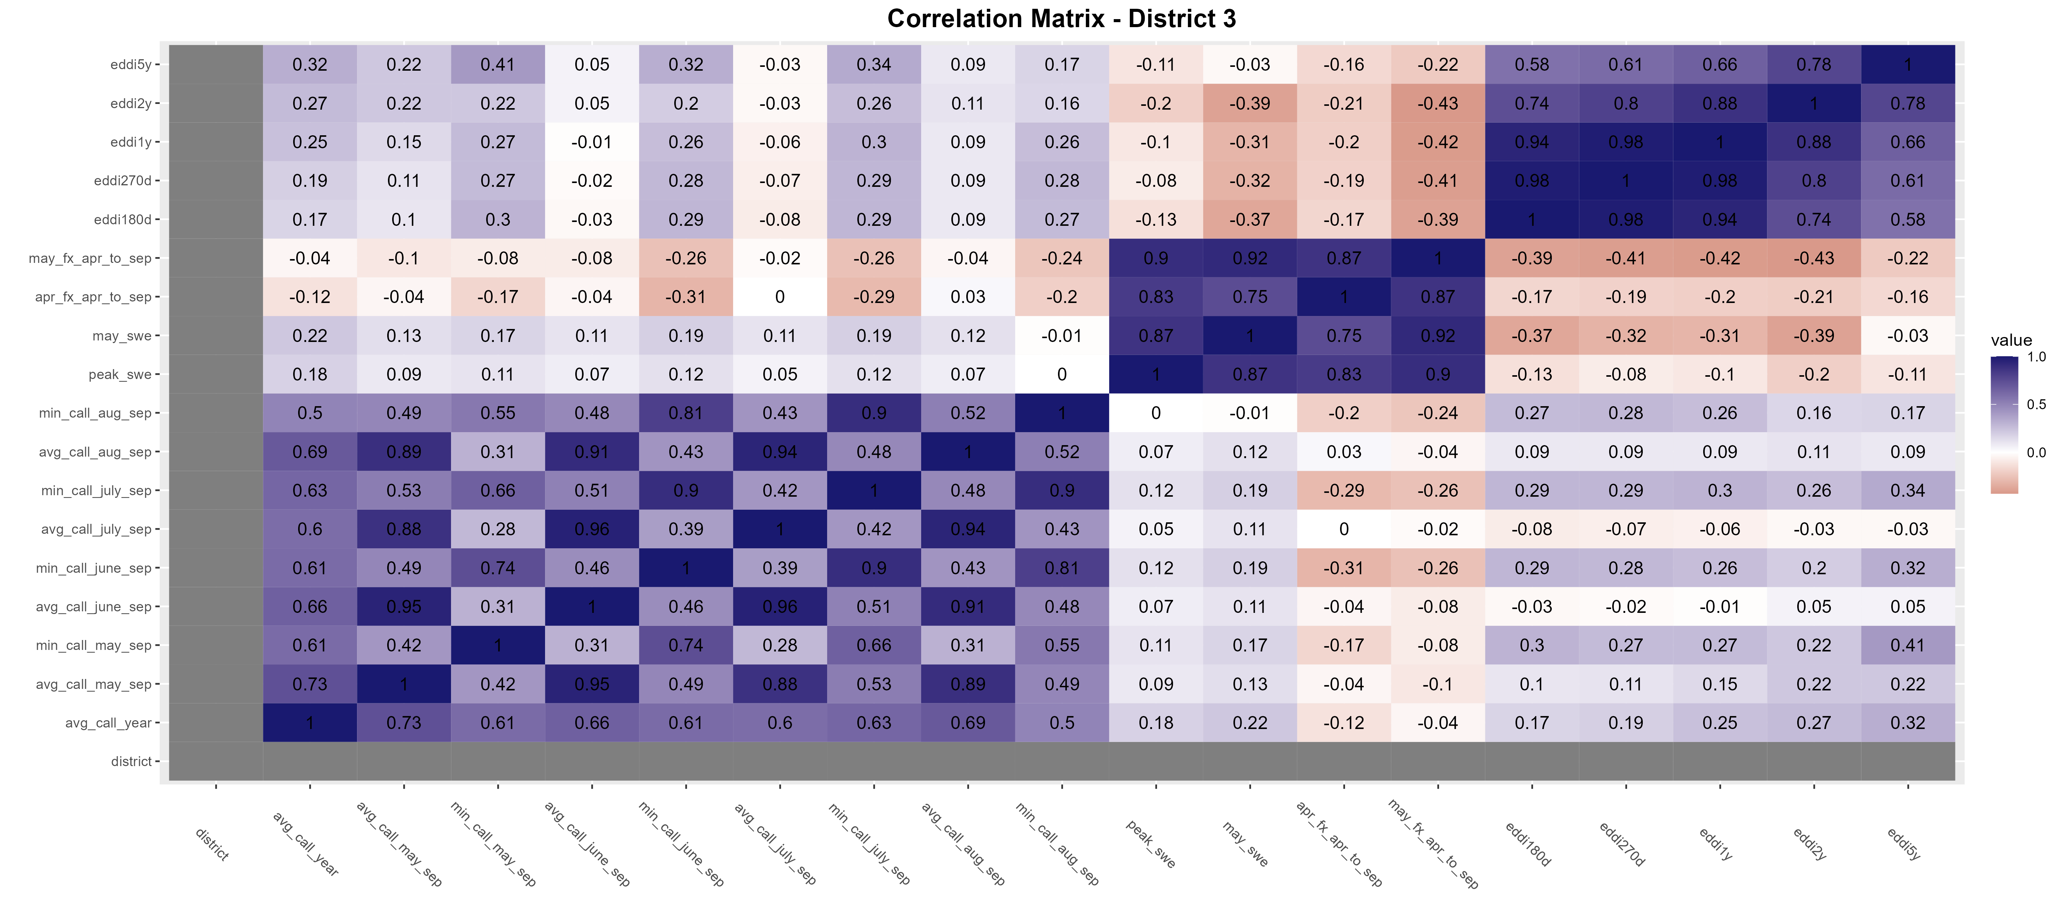
District 3
Dataset with all available years (dry and wet)

Slide 35
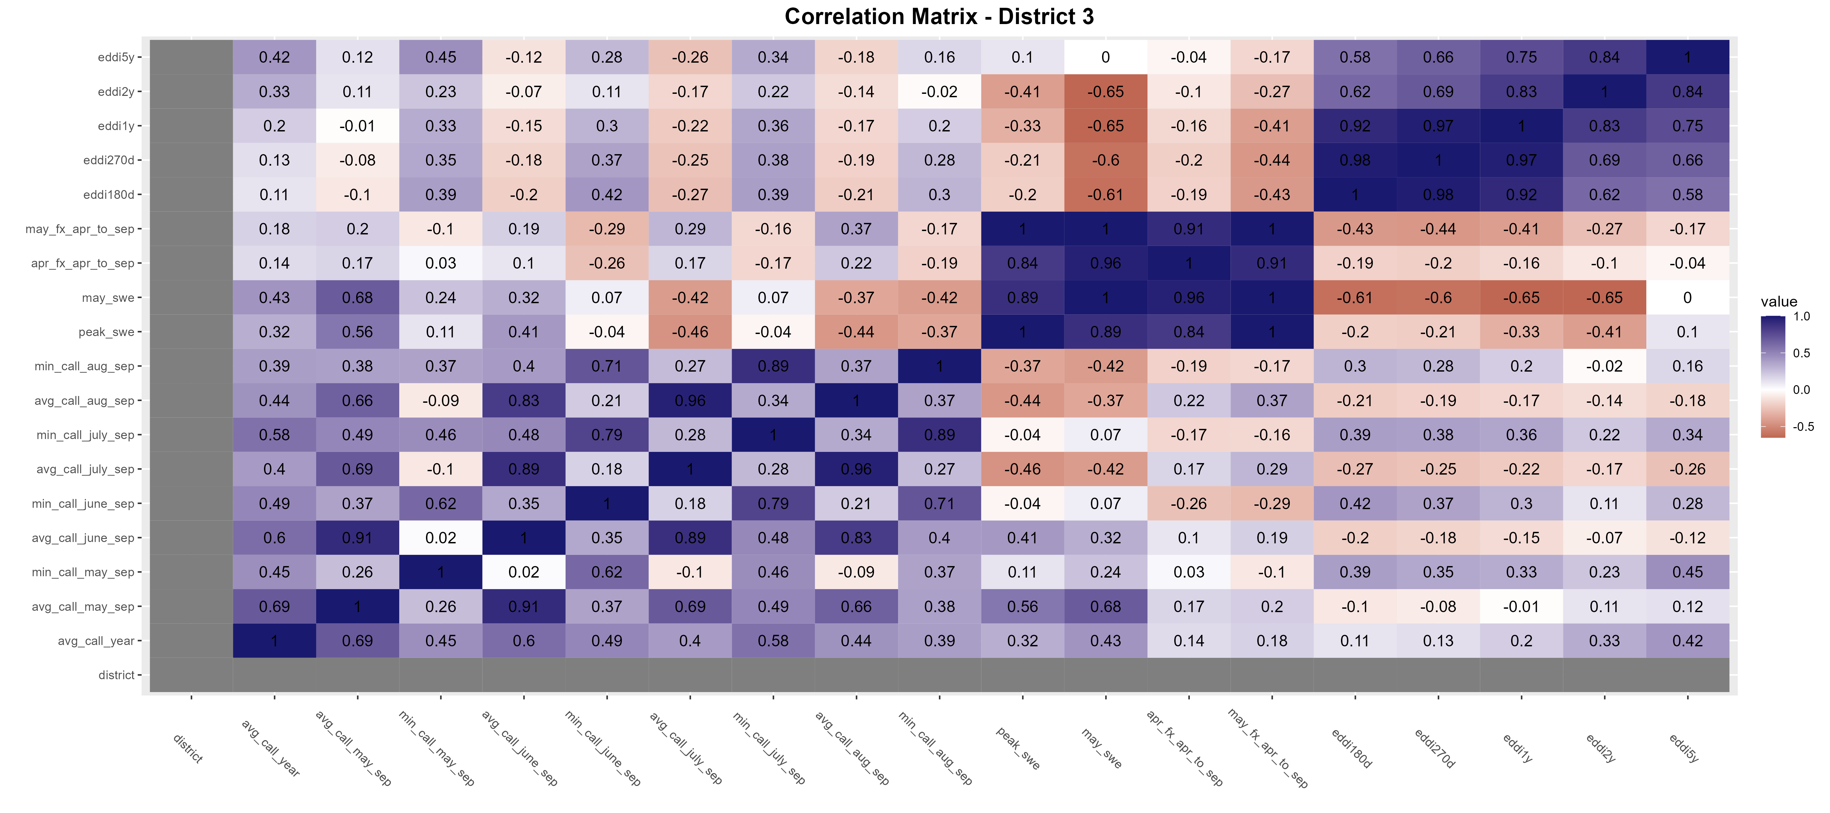
District 3
<=50th percentile flow

Slide 36
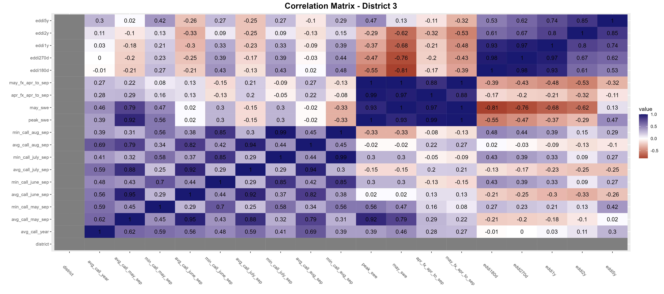
District 3
<=33rd percentile flow
Best pairing: EDDI180d vs min_call_aug_sep… but <0.5

Slide 37
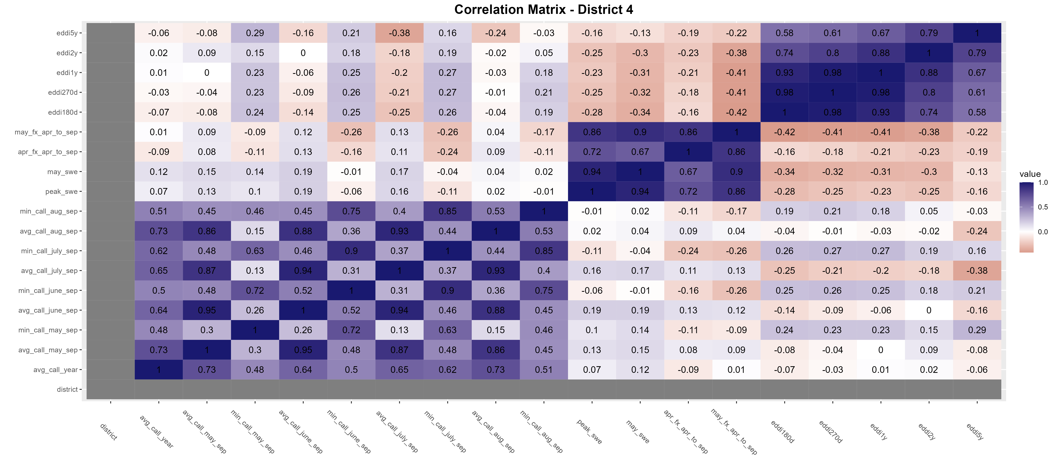
District 4
Dataset with all available years (dry and wet)

Slide 38
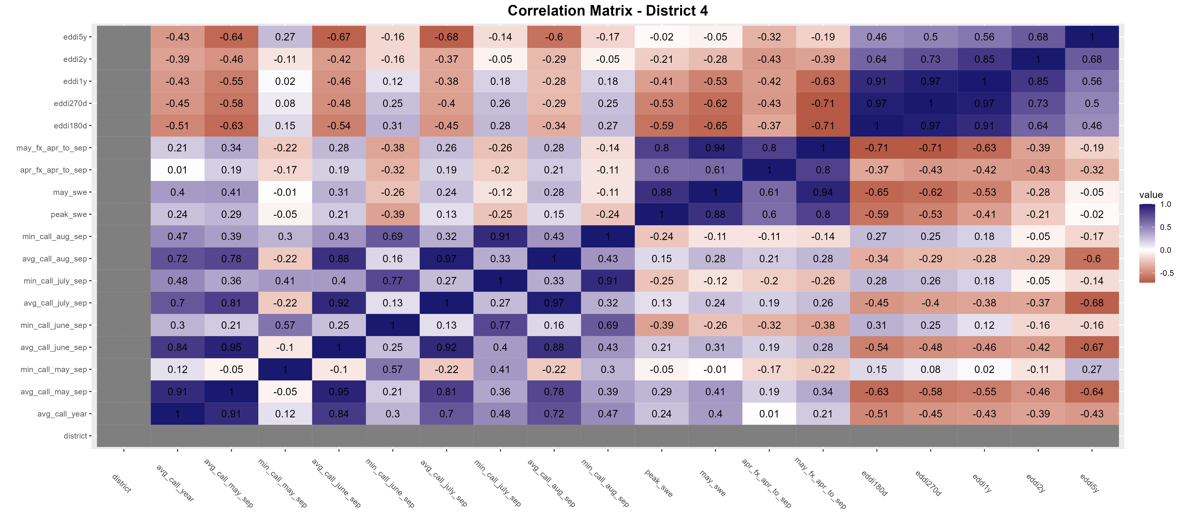
District 4
<=50th percentile flow

Slide 39
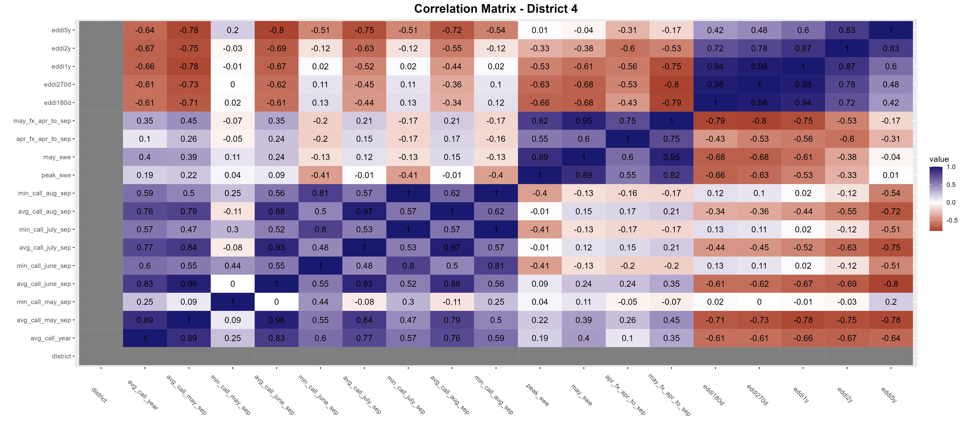
District 4
<=33rd percentile flow
Best pairing: May NRCS forecast vs avg_call_may_sep… but <0.5

Slide 40
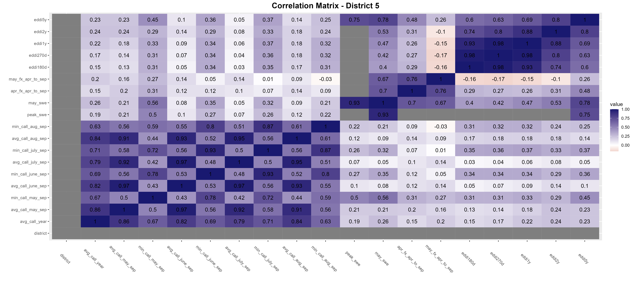
District 5
Dataset with all available years (dry and wet)

Slide 41
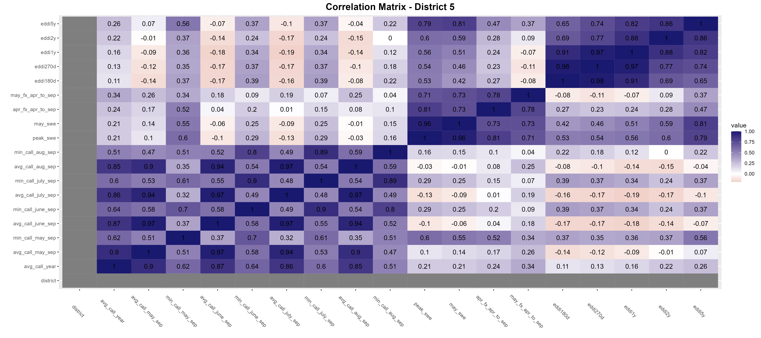
District 5
<=50th percentile flow
Best pairing: April NRCS forecast vs min_call_may_sep

Slide 42
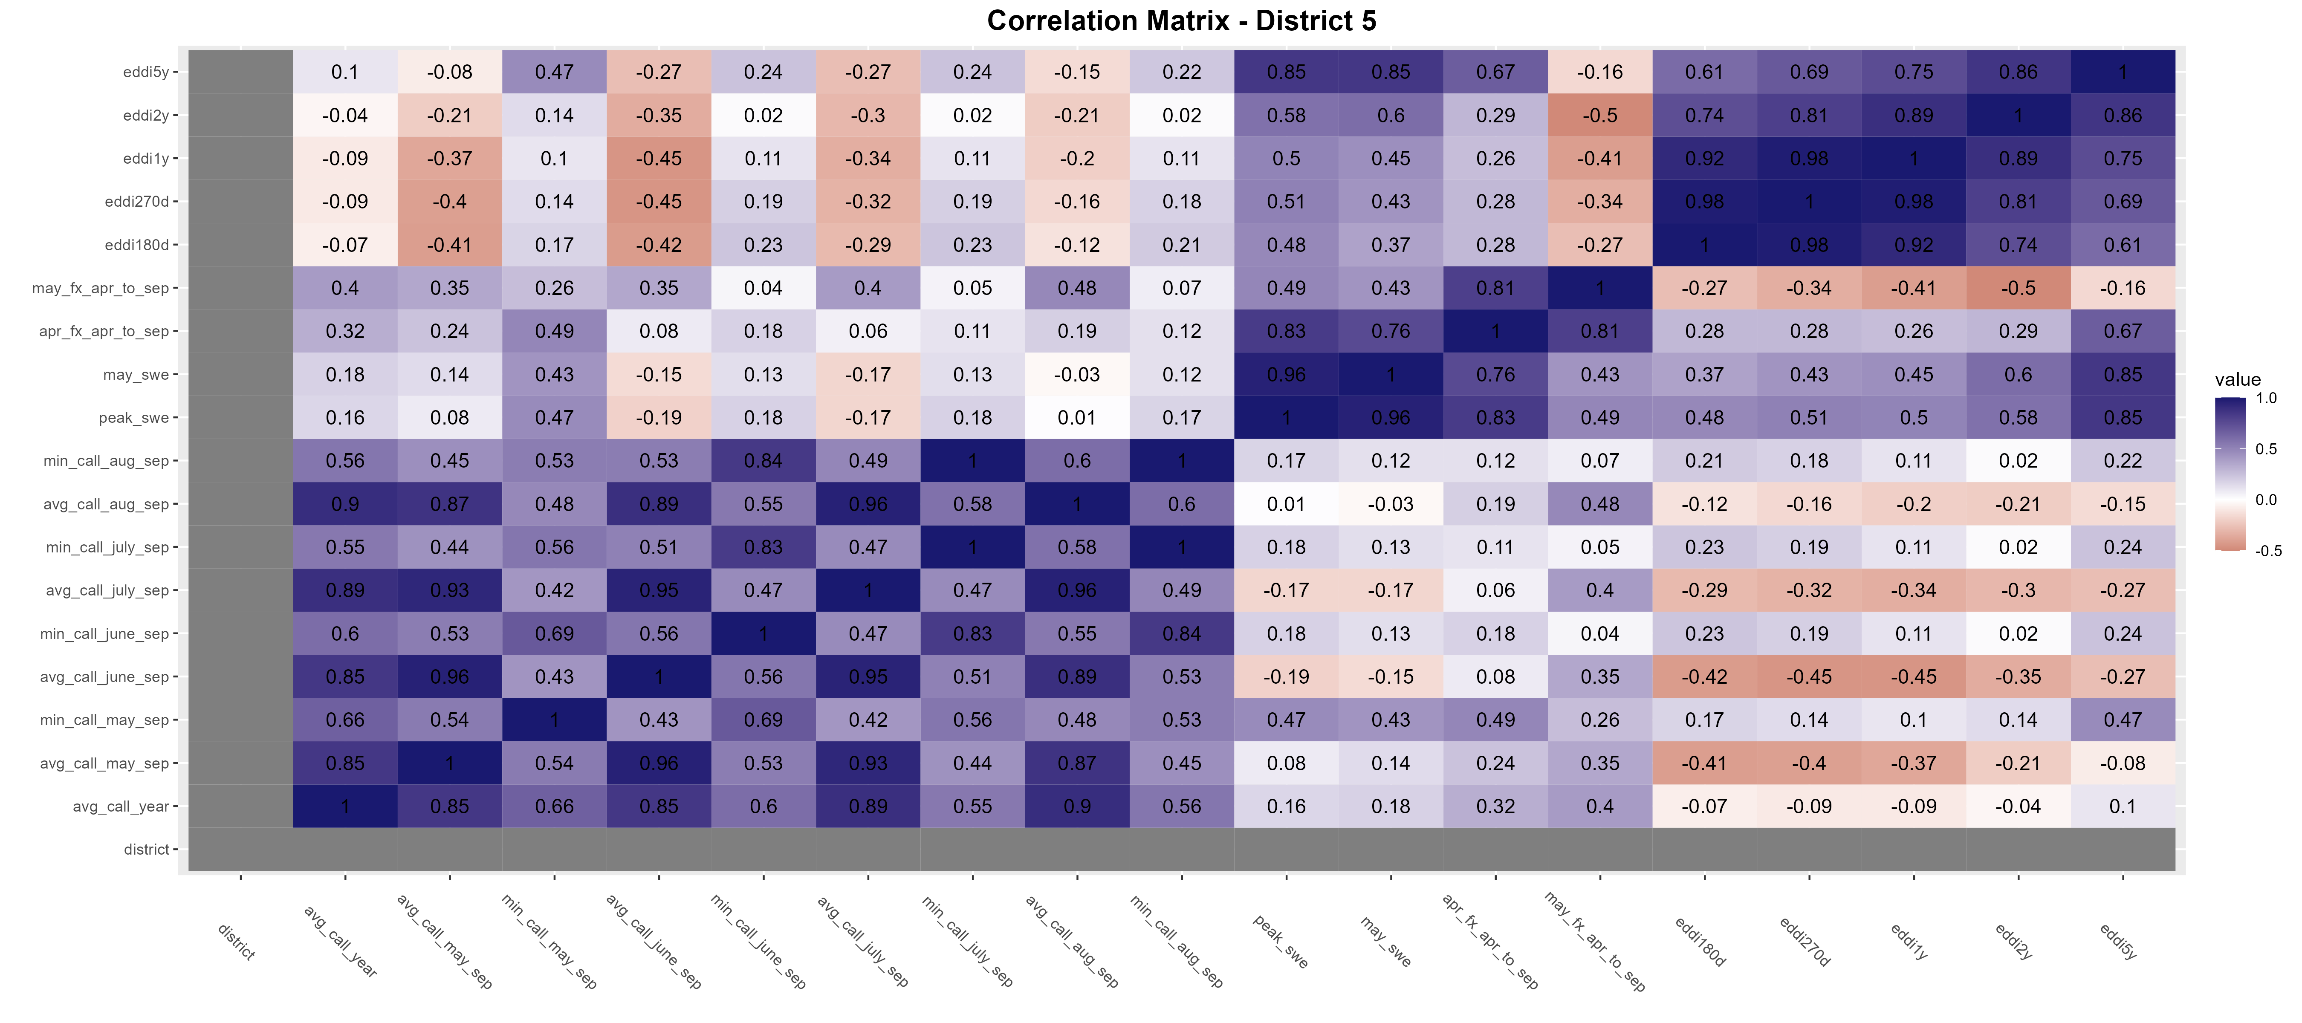
District 5
<=33rd percentile flow

Slide 43
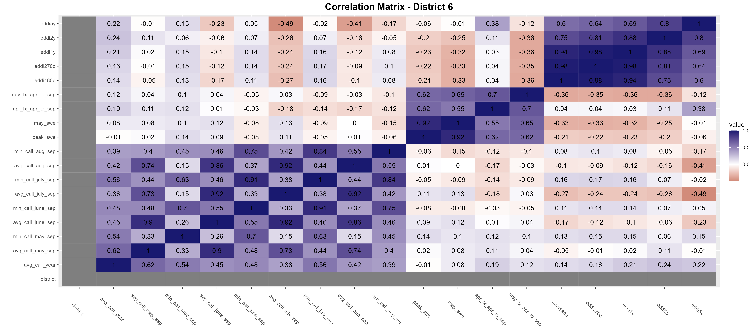
District 6
Dataset with all available years (dry and wet)

Slide 44
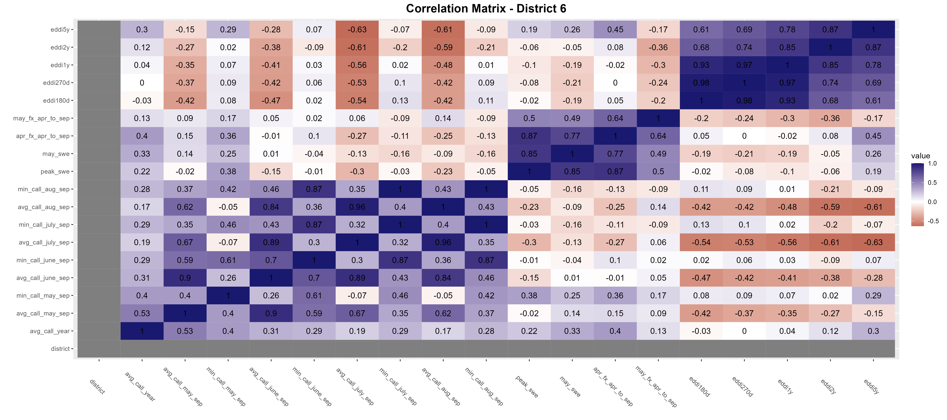
District 6
<=50th percentile flow

Slide 45
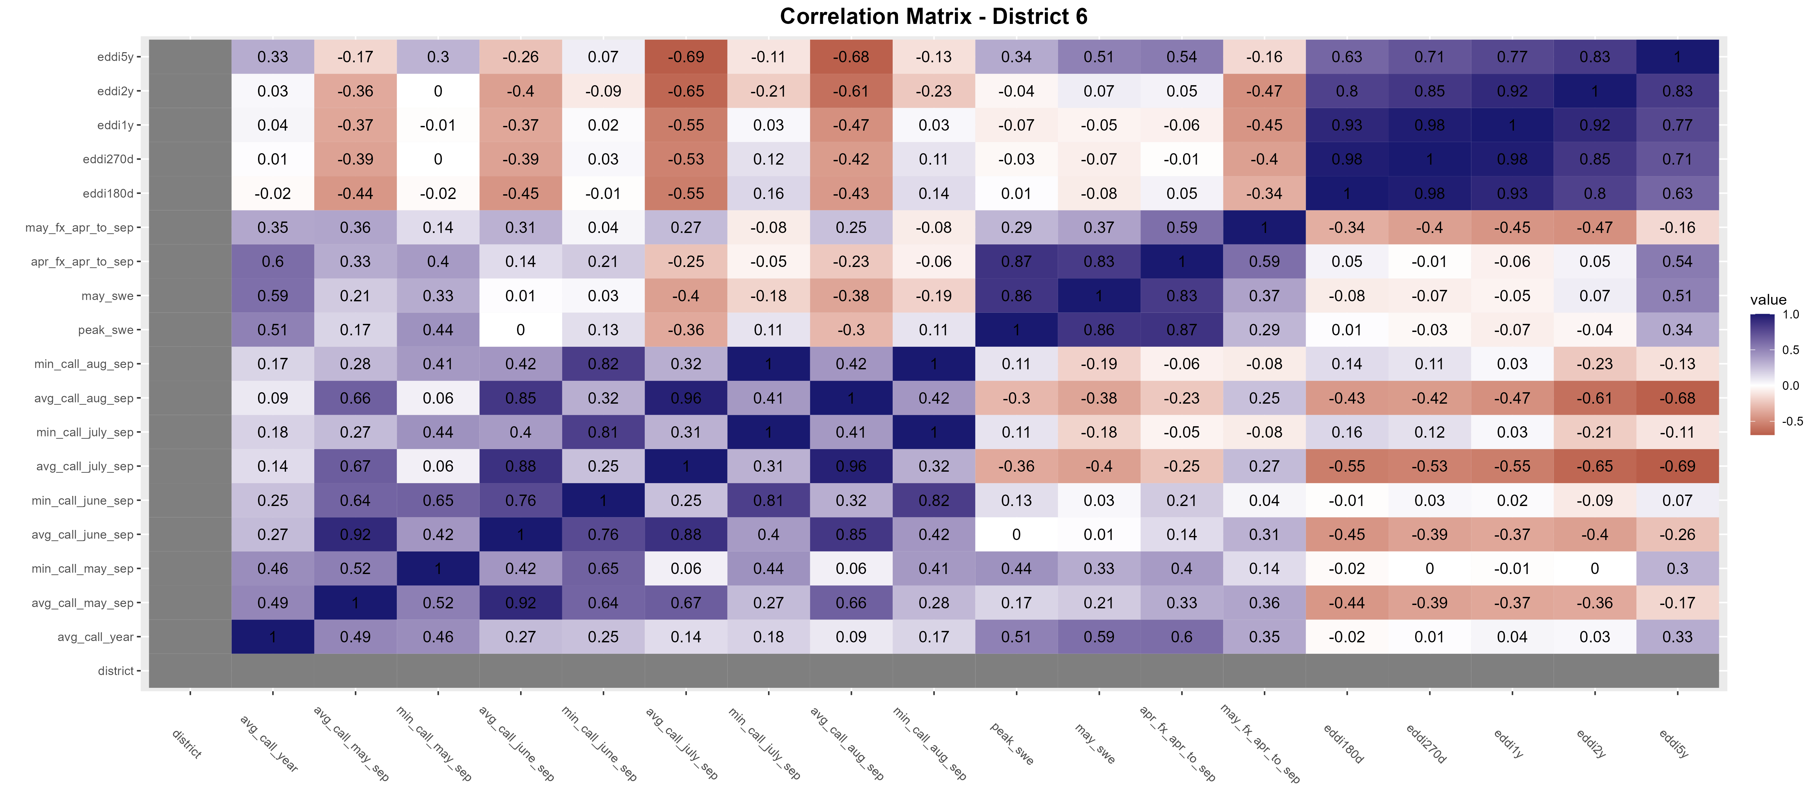
District 6
<=33rd percentile flow
Best pairing: April NRCS forecast vs avg_call_year

Slide 46
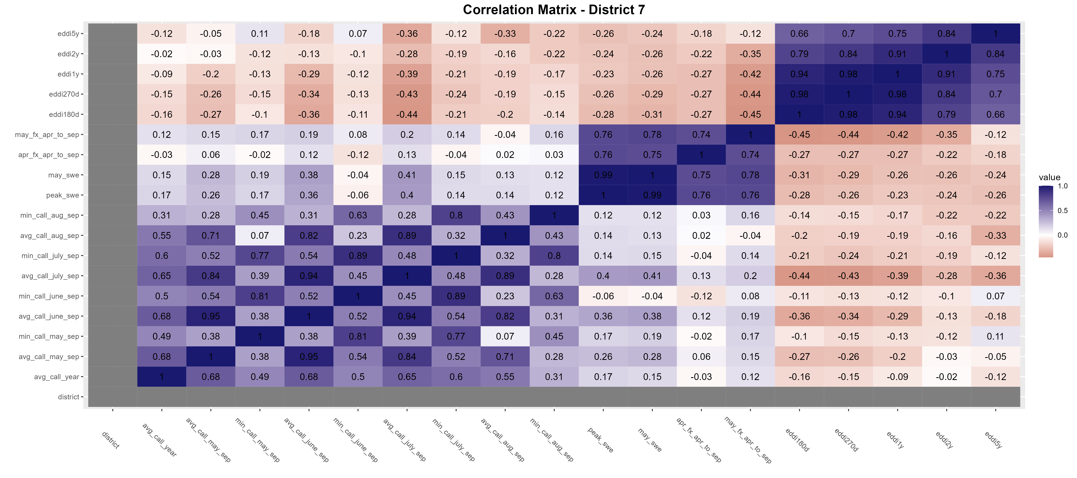
District 7
Dataset with all available years (dry and wet)

Slide 47
District 7
<=50th percentile flow
Best pairing: May NRCS forecast vs avg_call_may_sep

Slide 48
District 7
<=33rd percentile flow

Slide 49
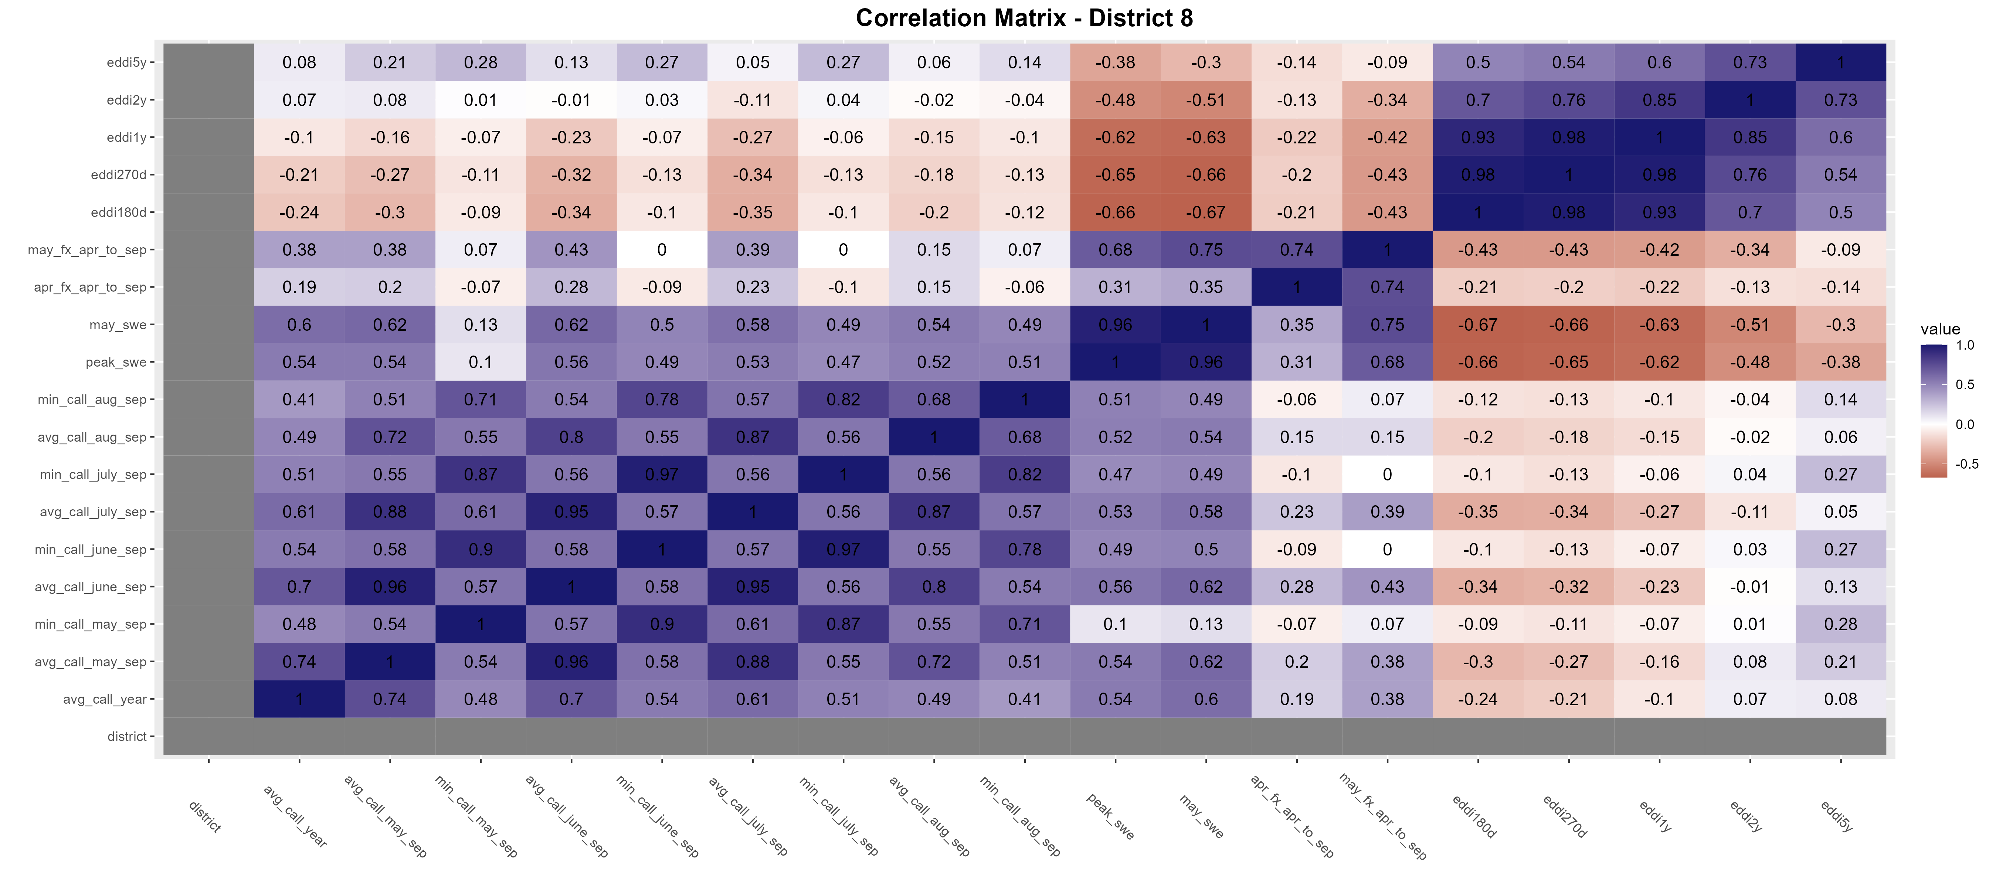
District 8
Dataset with all available years (dry and wet)

Slide 50
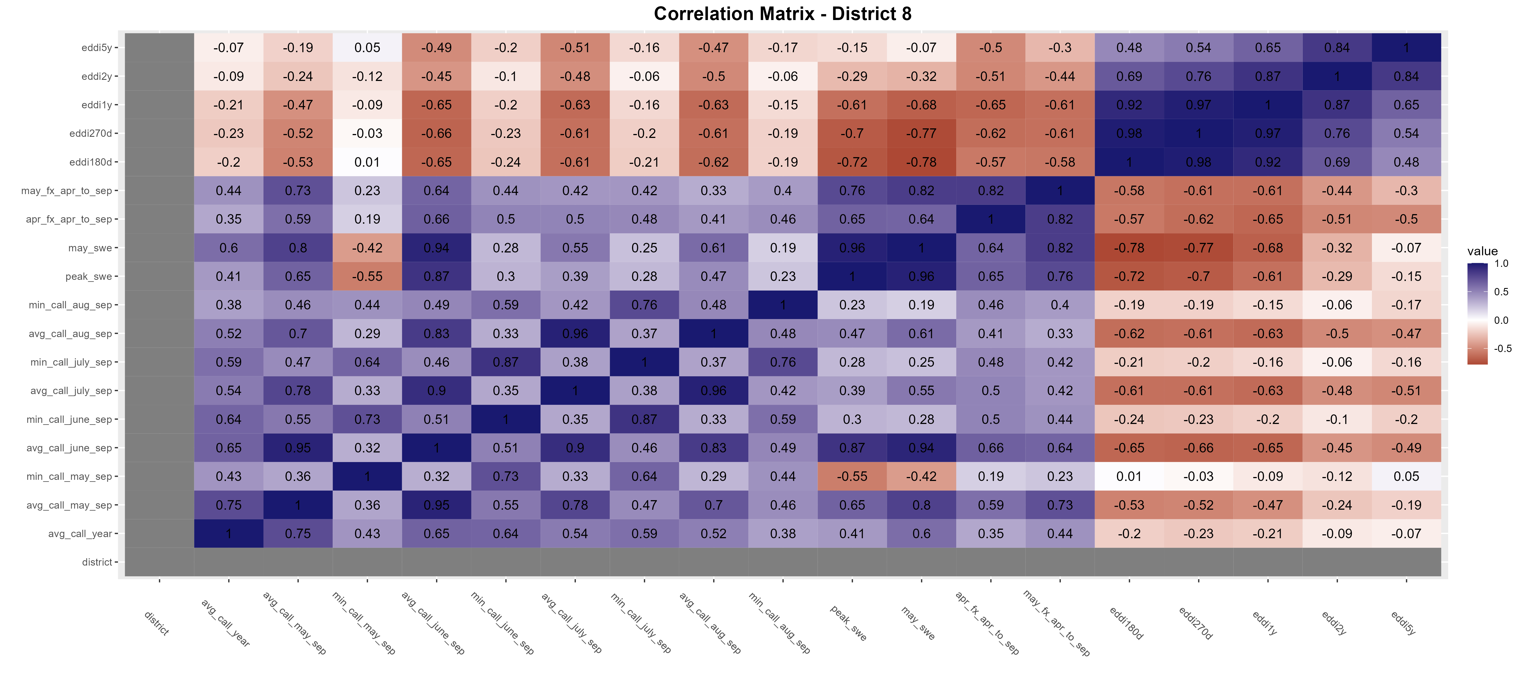
District 8
<=50th percentile flow

Slide 51
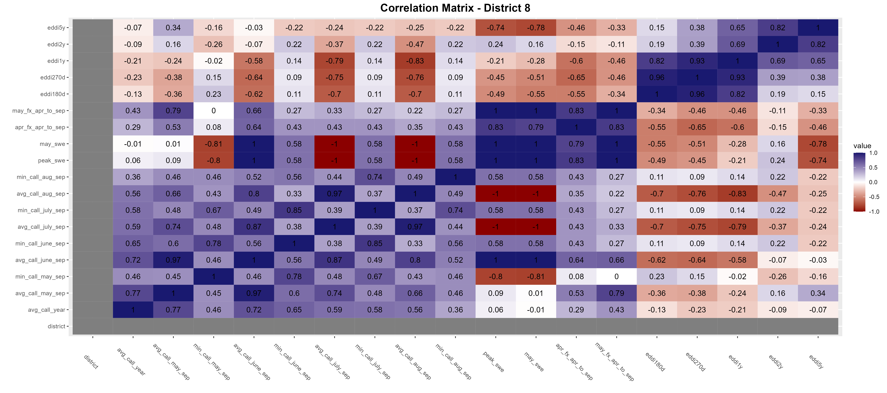
District 8
<=33rd percentile flow
Best pairing: May NRCS forecast vs avg_call_may_sep

Slide 52
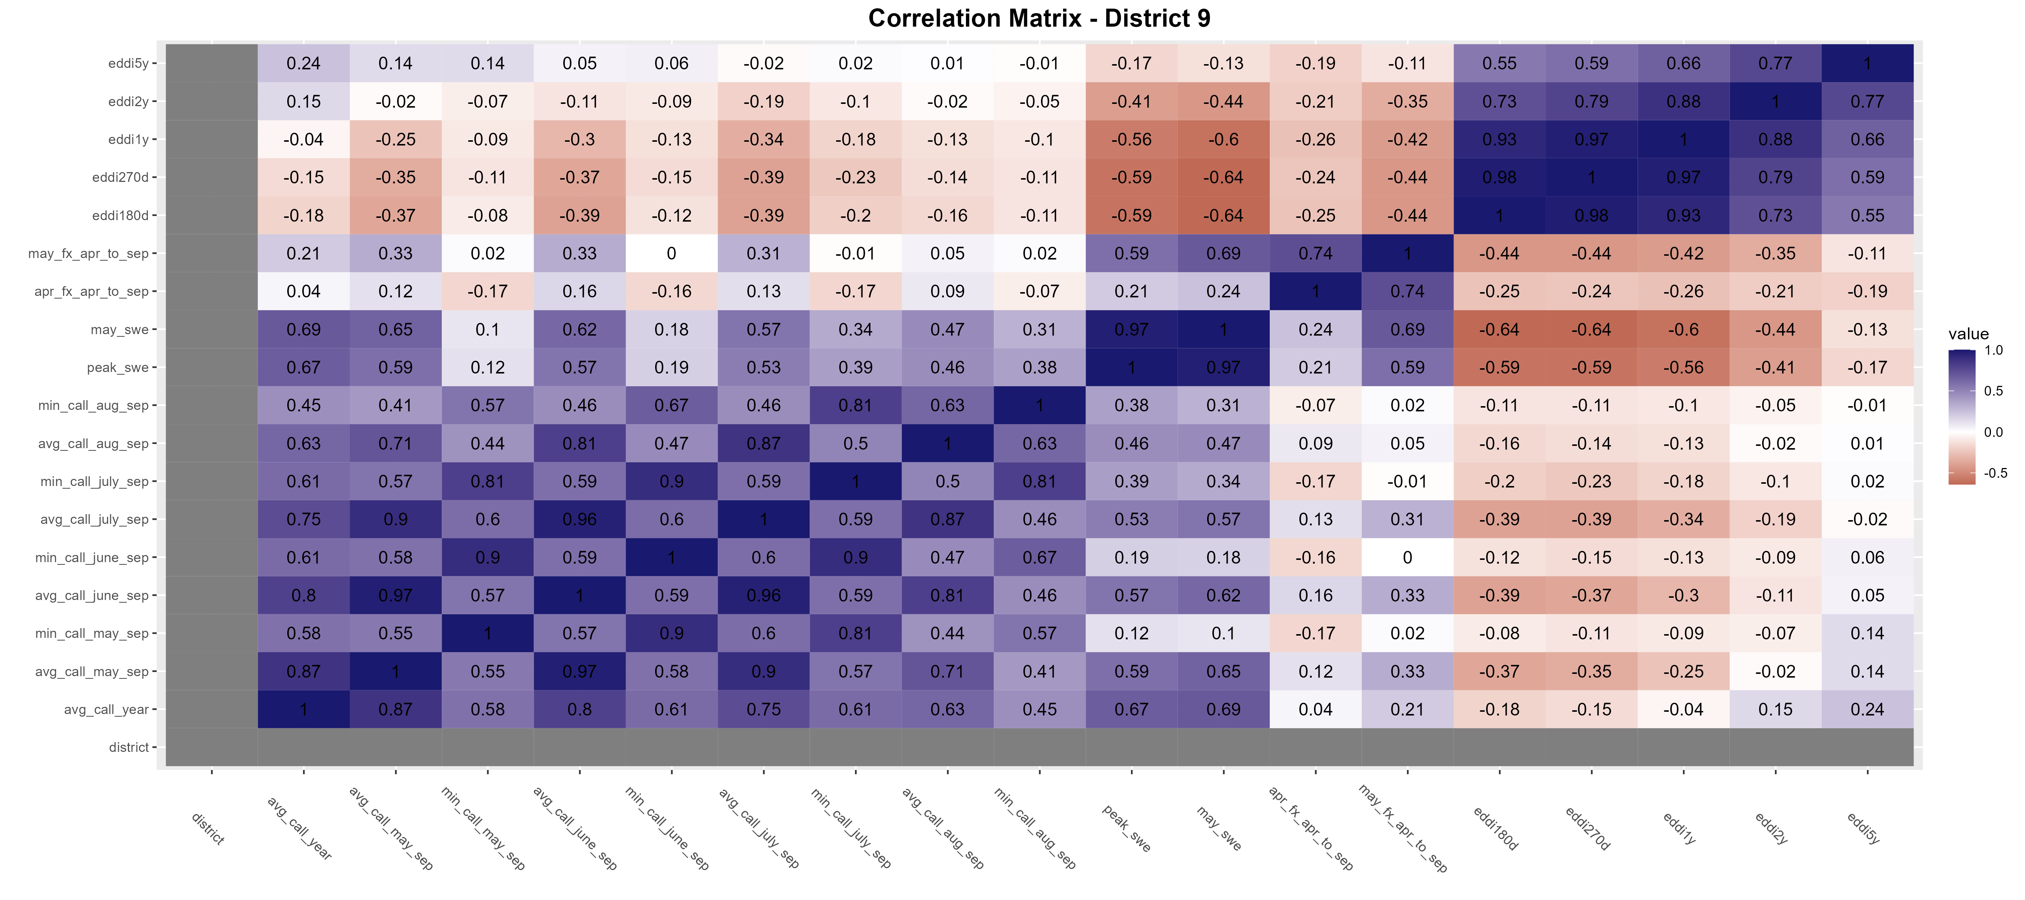
District 9
Dataset with all available years (dry and wet)

Slide 53
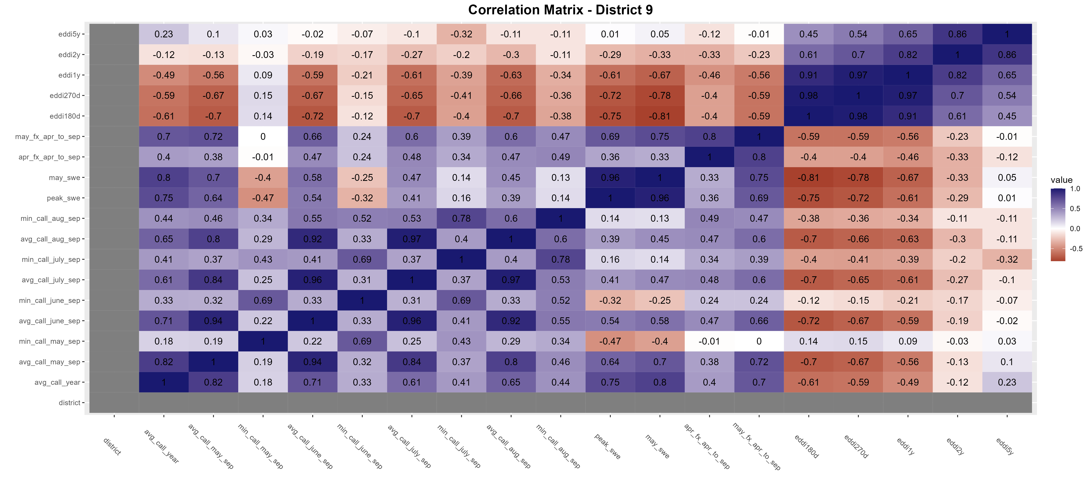
District 9
<=50th percentile flow
Best pairing: May NRCS forecast vs avg_call_year/avg_call_may_sep

Slide 54
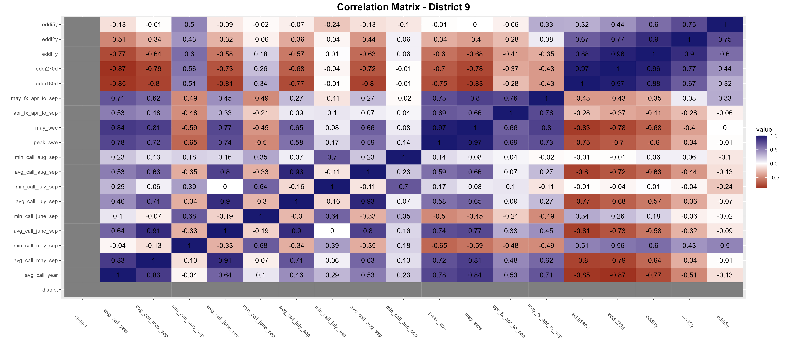
District 9
<=33rd percentile flow

Slide 55
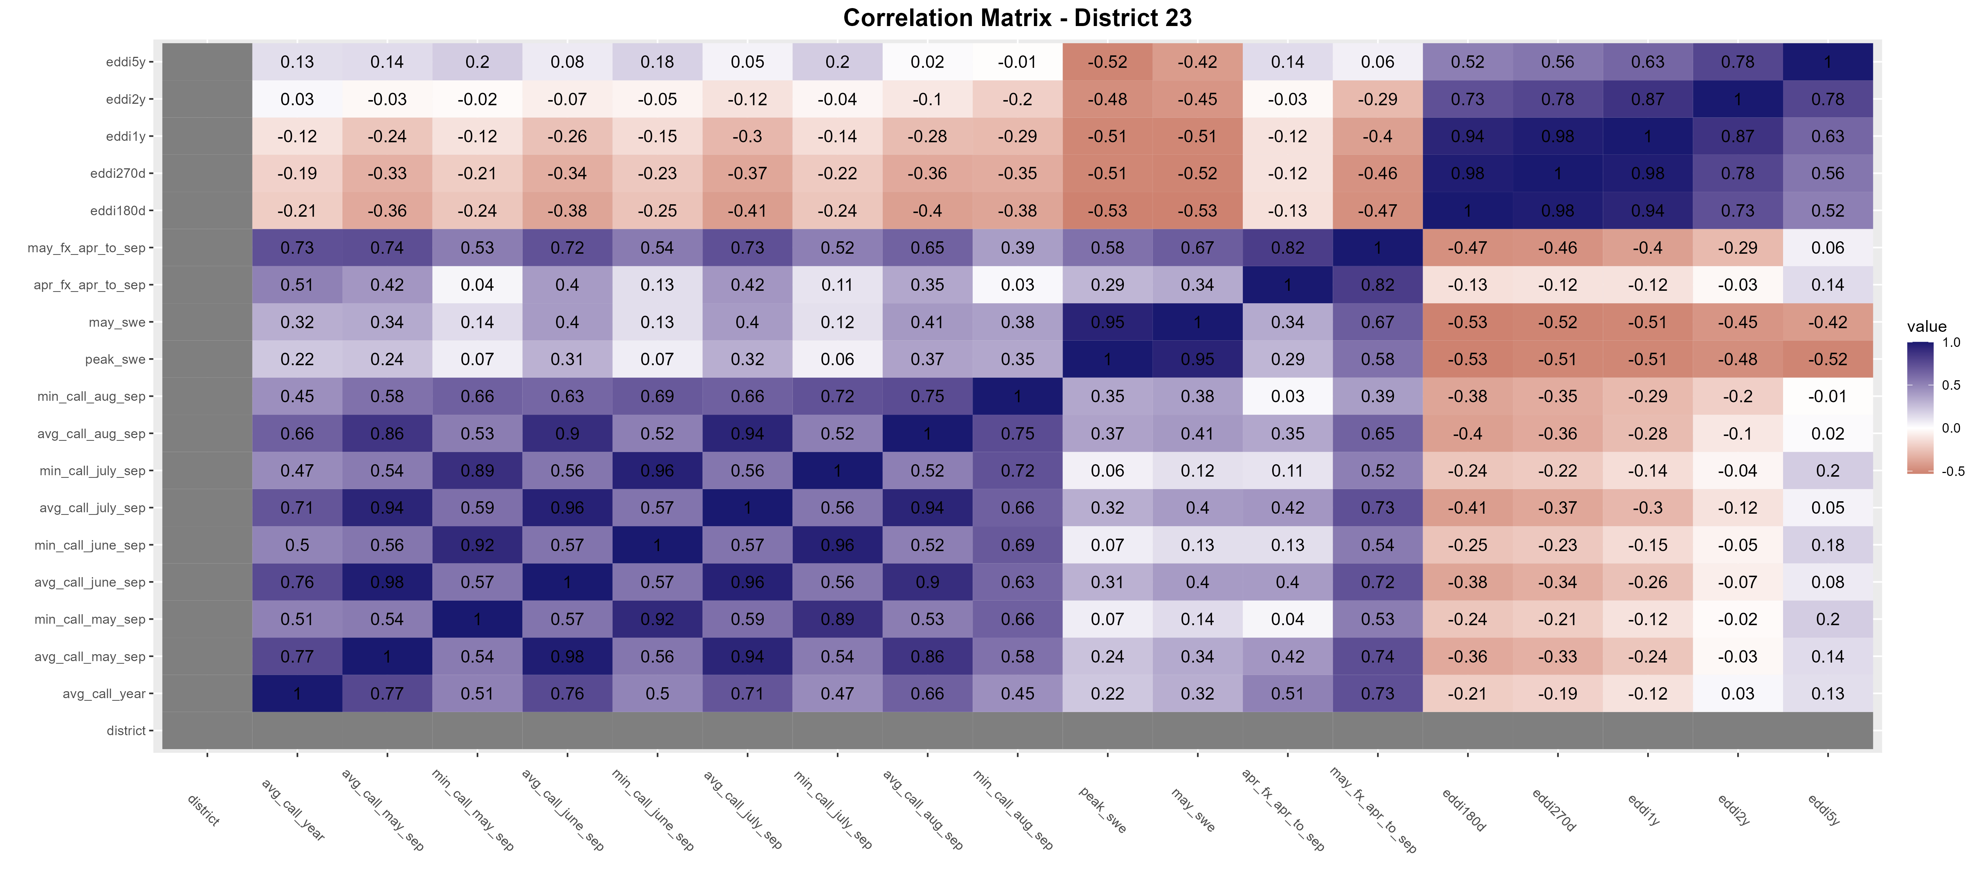
District 23
Dataset with all available years (dry and wet)

Slide 56
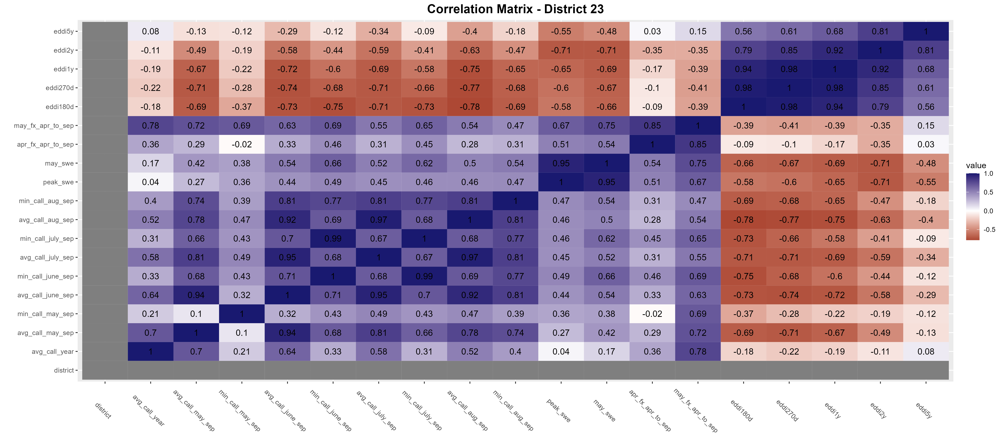
District 23
<=50th percentile flow

Slide 57
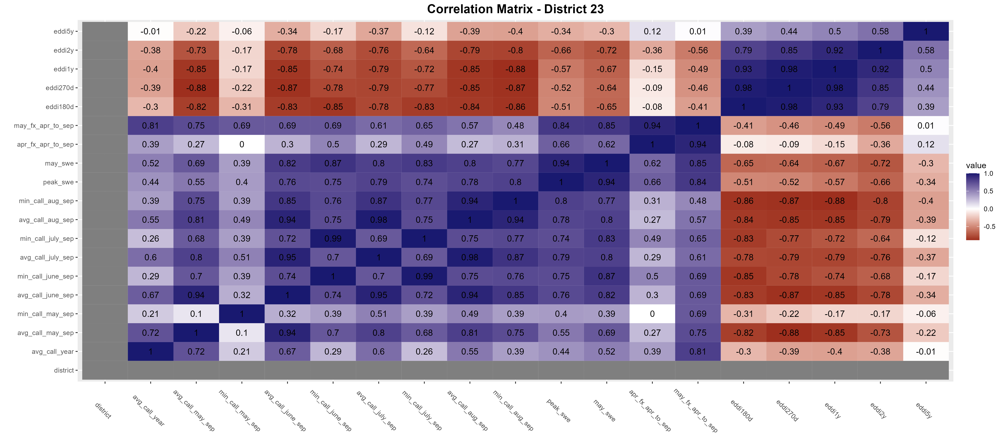
District 23
<=33rd percentile flow
Best pairing: May NRCS forecast vs avg_call_year/avg_call_may_sep

Slide 58
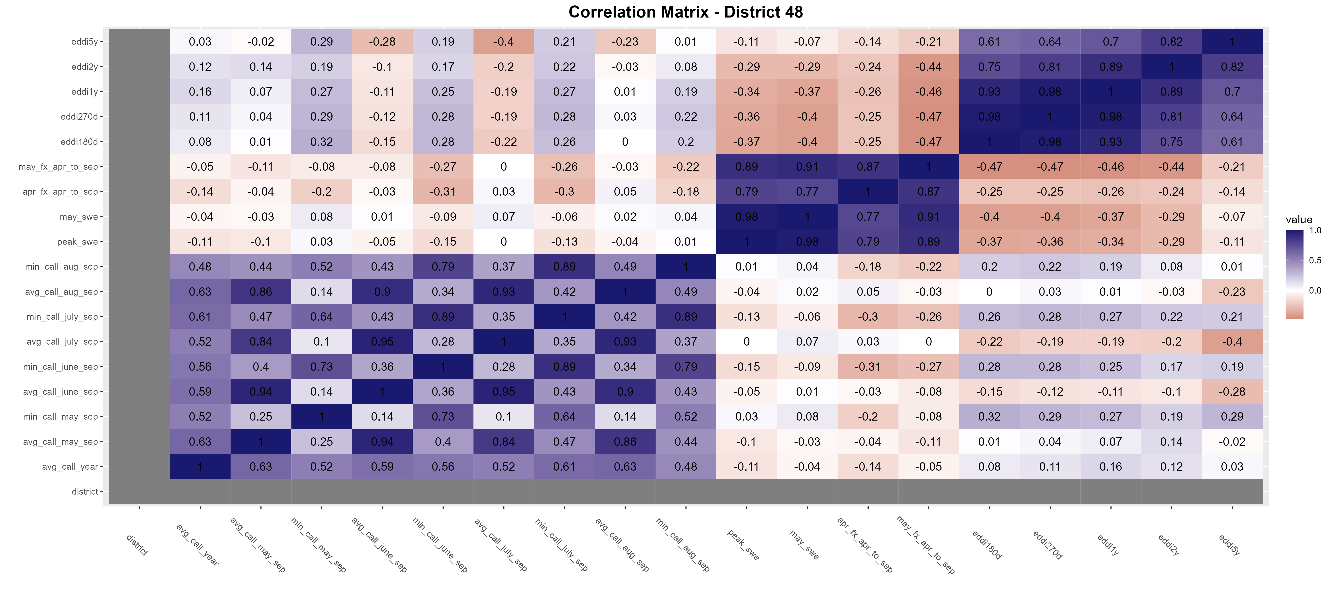
District 48
Dataset with all available years (dry and wet)

Slide 59
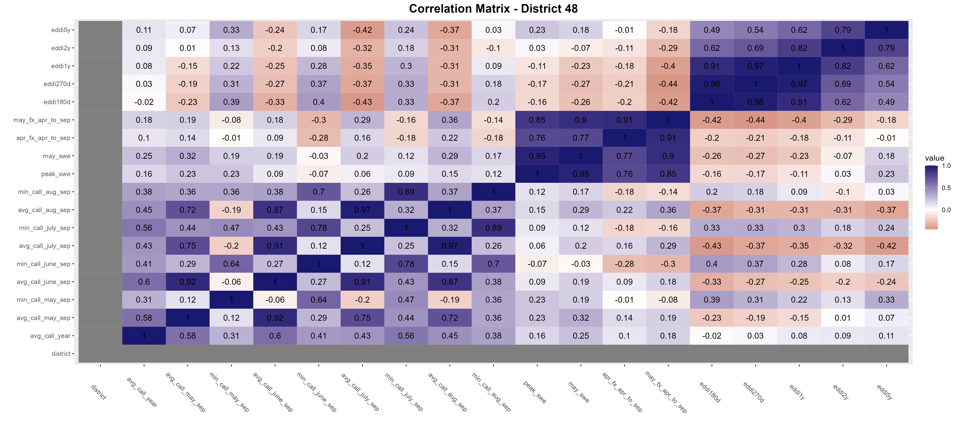
District 48
<=50th percentile flow

Slide 60
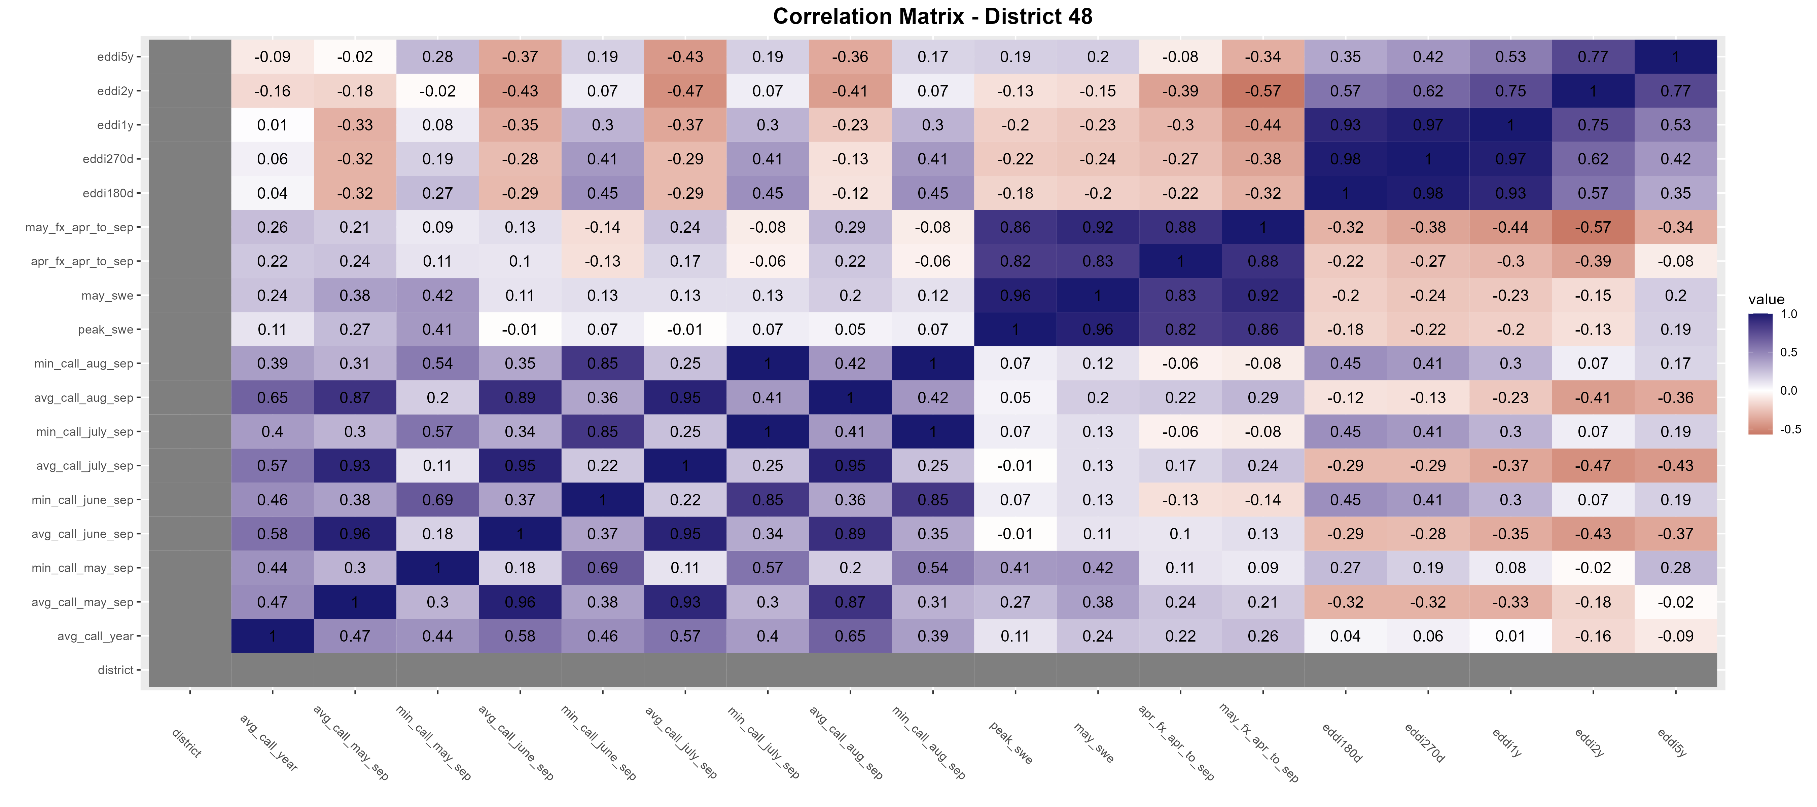
District 48
<=33rd percentile flow
Best pairing: EDDI180d vs min_call_June/july_sep… but <0.5

Slide 61
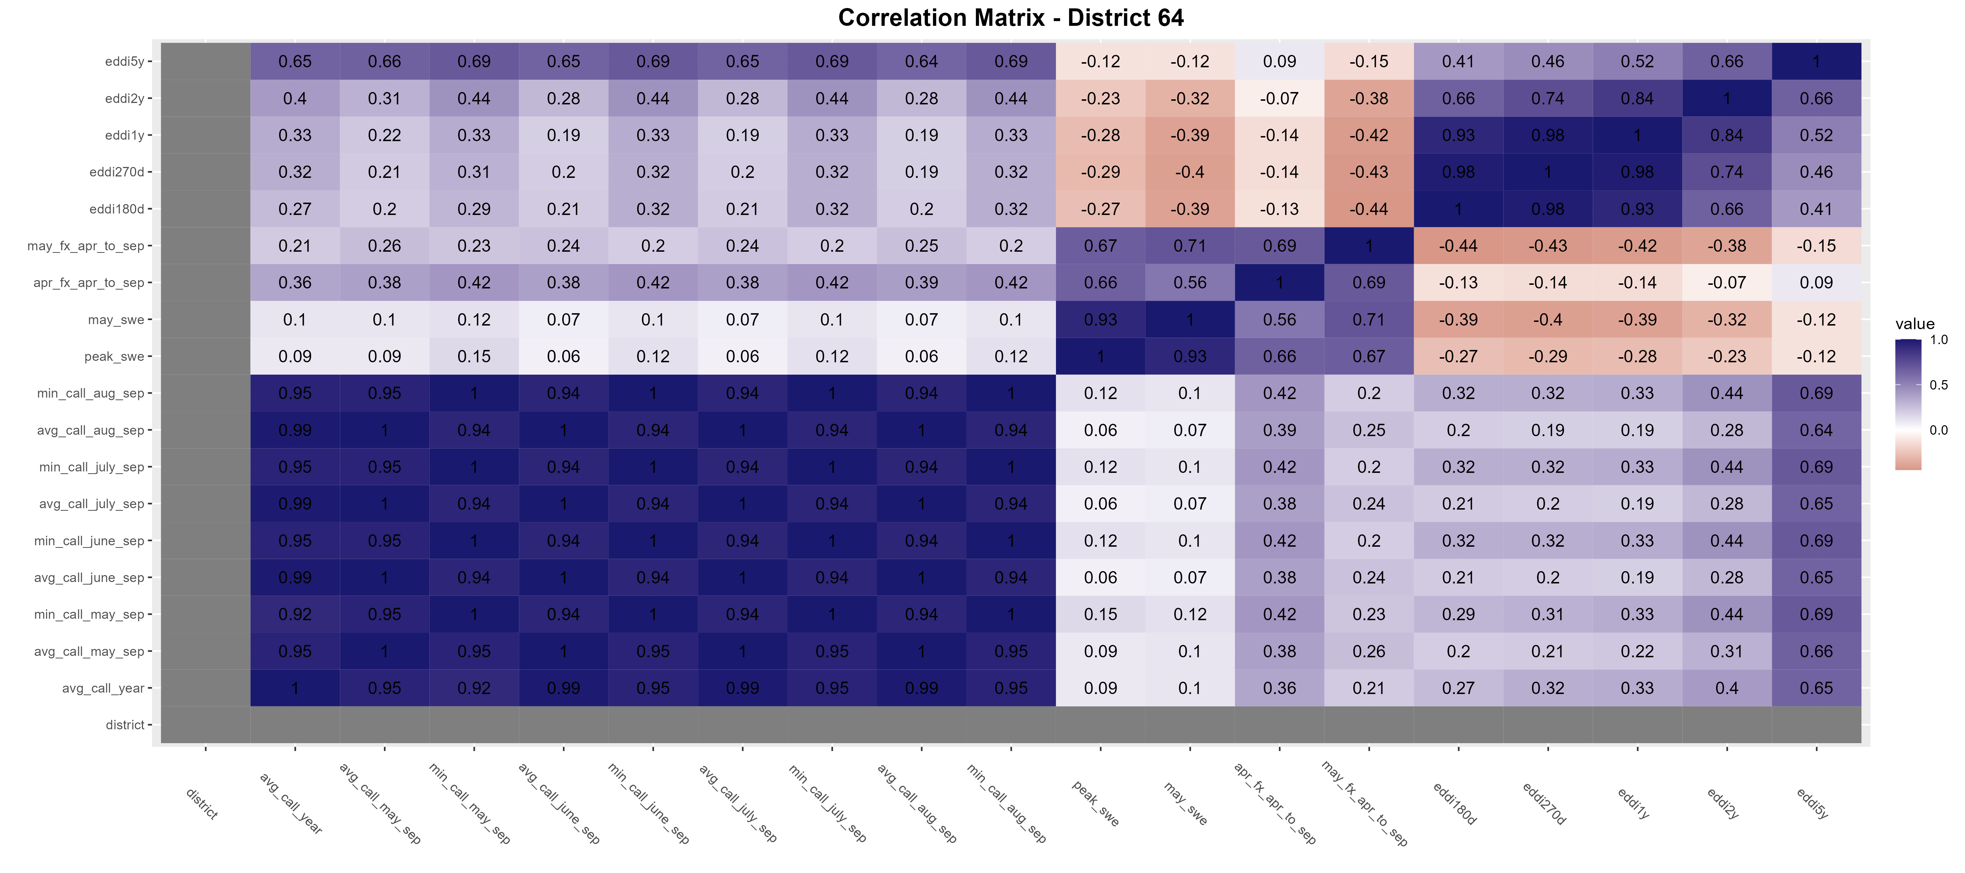
District 64
Dataset with all available years (dry and wet)
This is the only district where the dataset including all years seems to have a better performance between April NRCS forecast and call year… but the relationship is still <0.5 correlation.

Slide 62
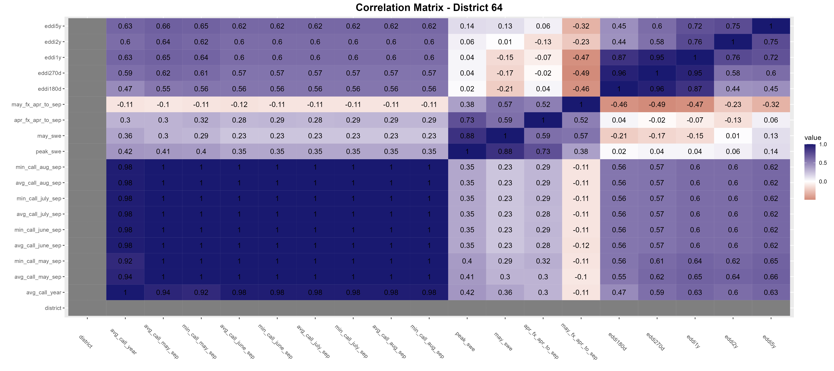
District 64
<=50th percentile flow
Best pairing: EDDI180d vs avg_call_June/July/aug_sep

Slide 63
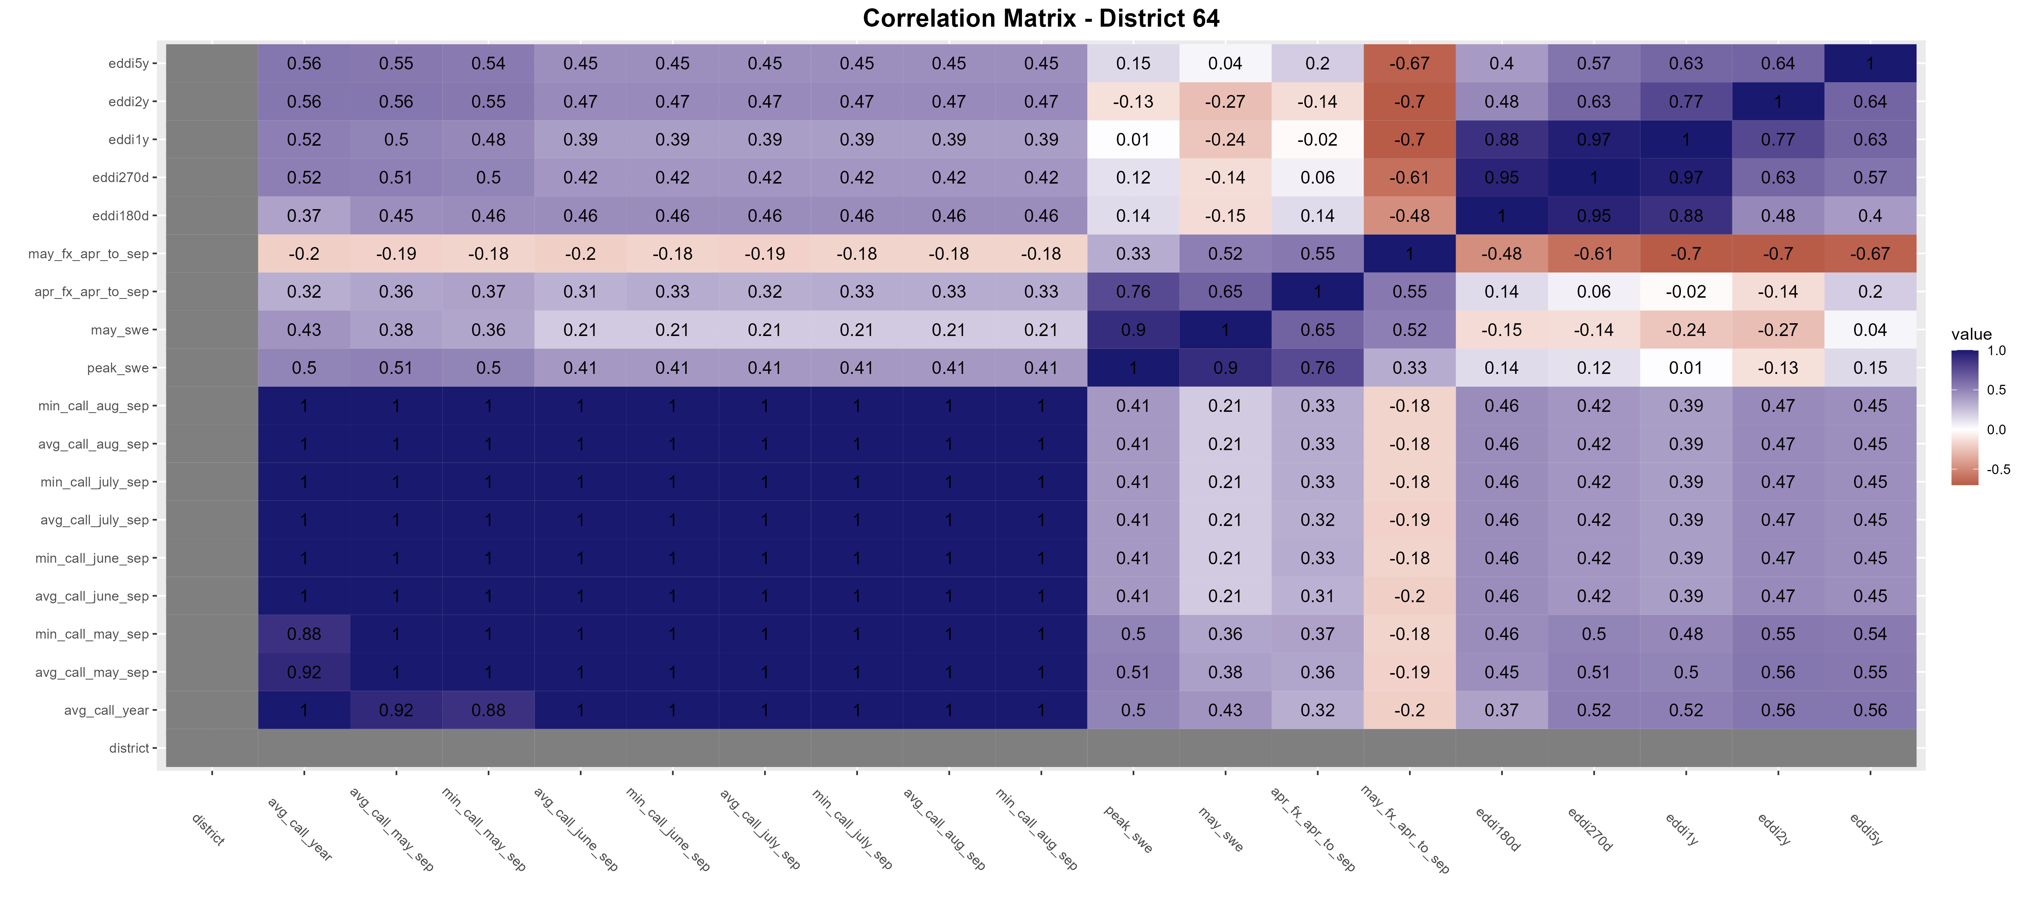
District 64
<=33rd percentile flow

Slide 64
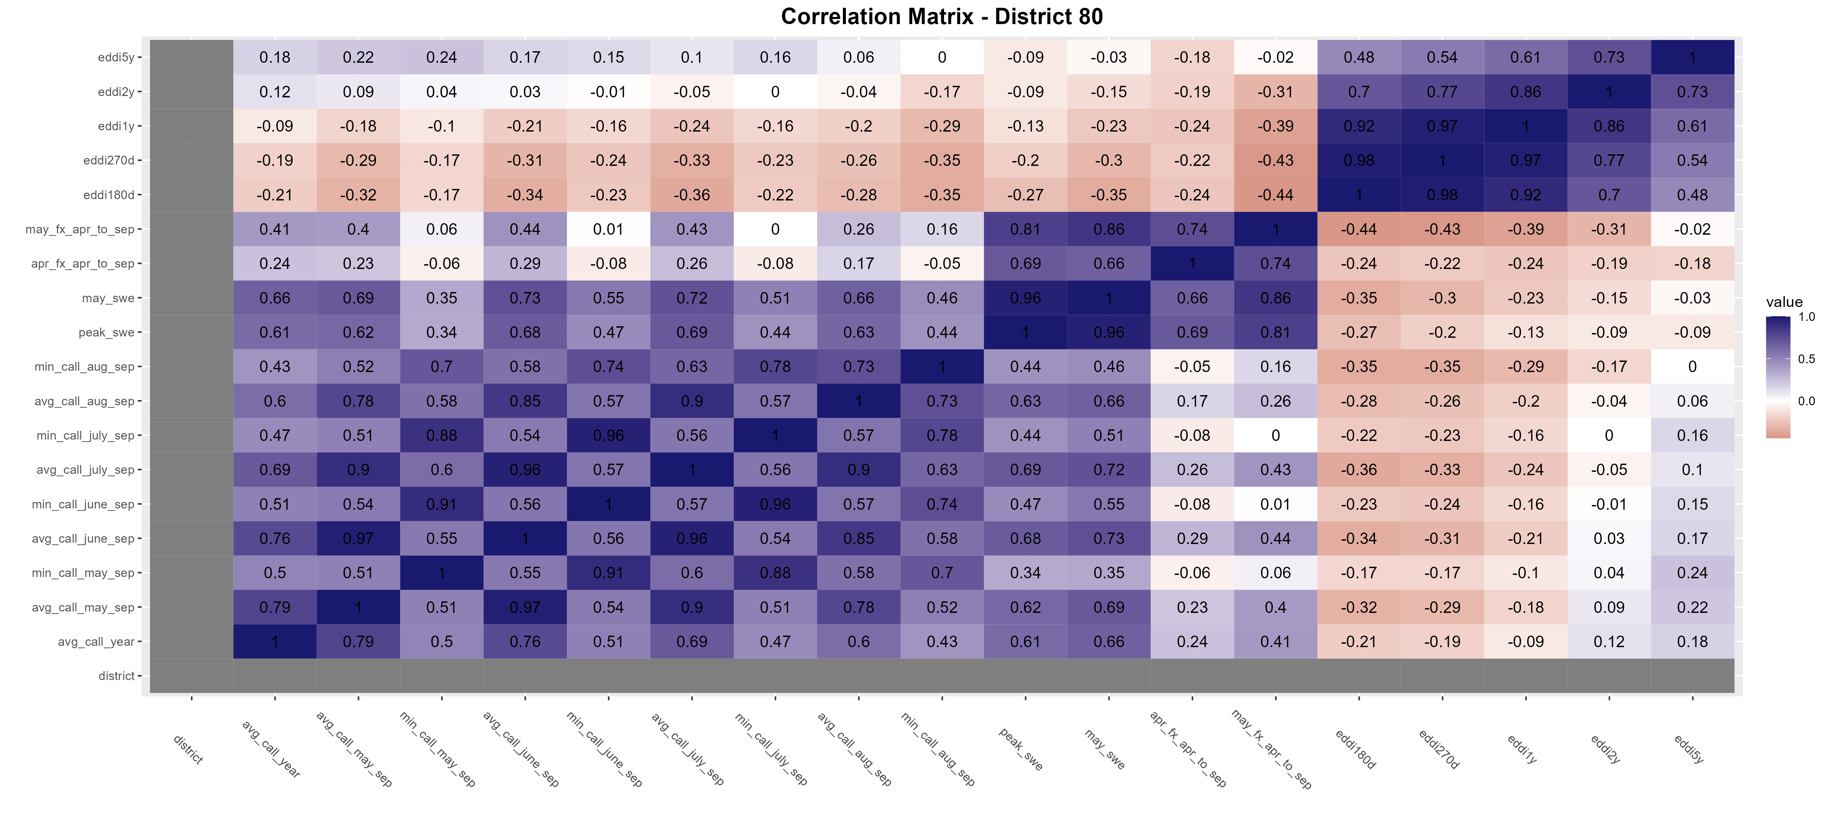
District 80
Dataset with all available years (dry and wet)

Slide 65
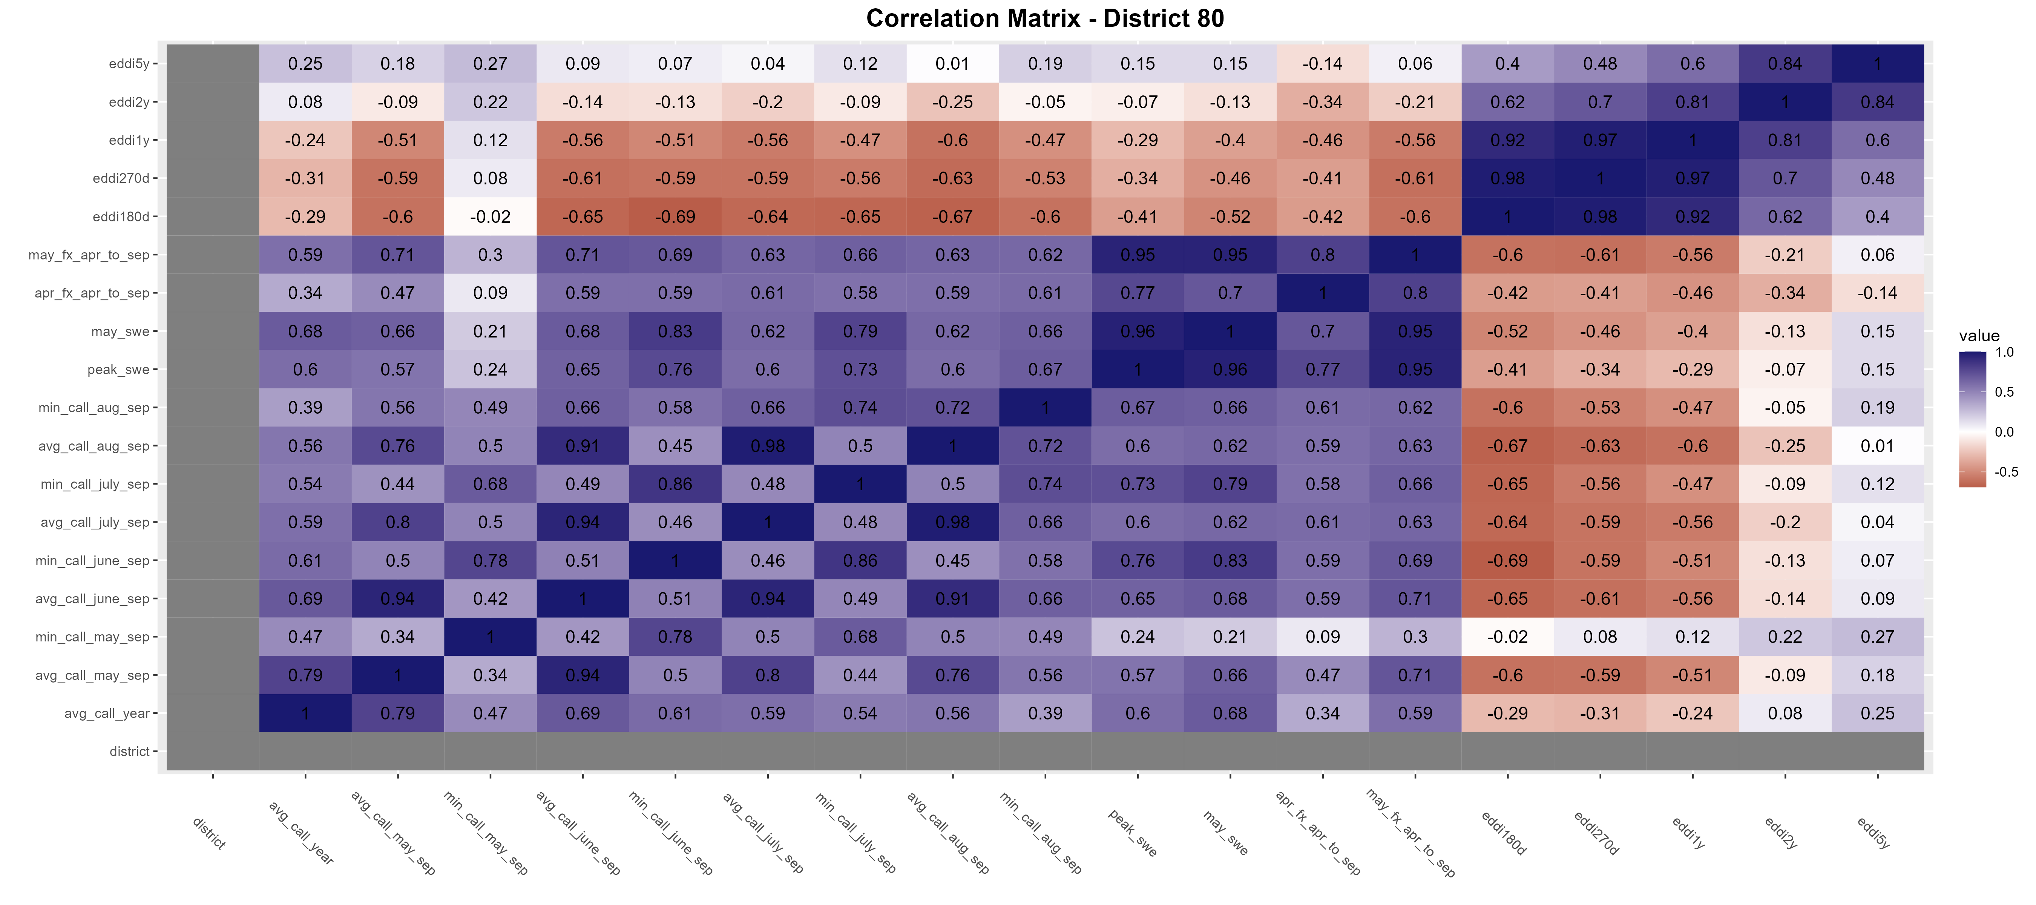
District 80
<=50th percentile flow
Best pairing: May NRCS forecast vs avg_call_may_sep

Slide 66
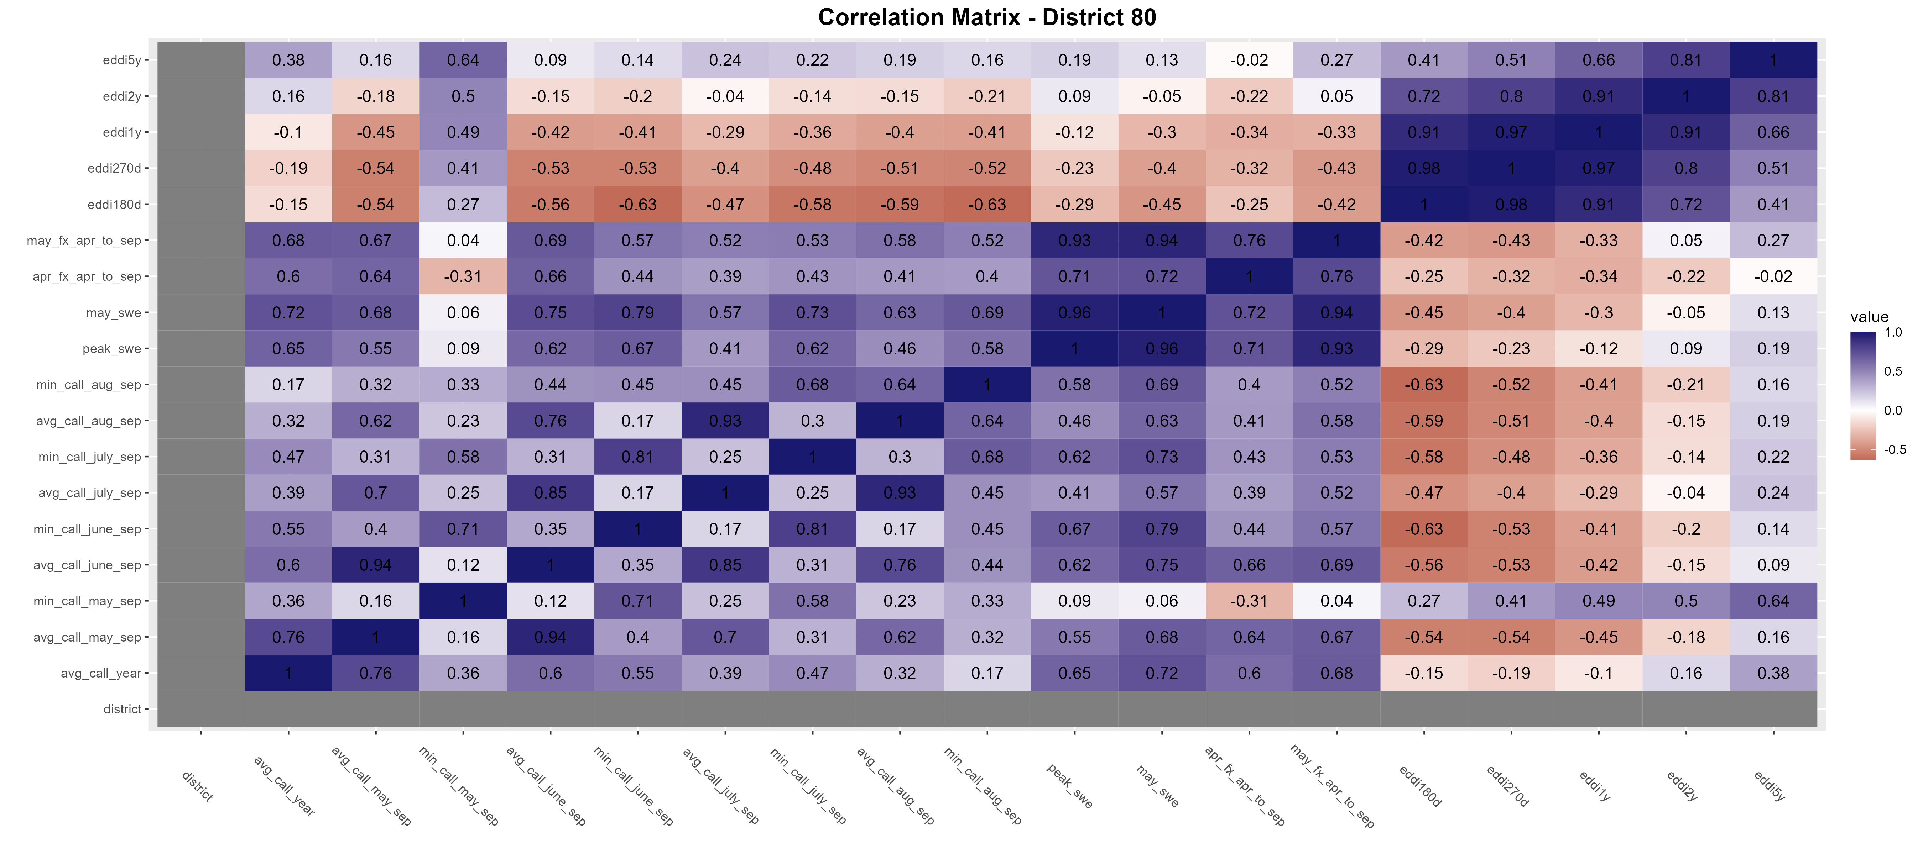
District 80
<=33rd percentile flow

Slide 67
Findings Summary of best pairings for each district (*gray had best correlations below 0.5)
District | Full dataset (all years) | Below median dataset (dry years) | Lower tercile dataset (driest years) | Best response var | Best predictor(s)
1 |  |  | X | Avg call year | April NRCS forecast
2 |  |  | X | Avg call year | April NRCS forecast
3 |  |  | X | Min call aug-sep | EDDI180d
4 |  |  | X | Avg call may-sep | May NRCS forecast
5 |  | X |  | Min call may-sep | April NRCS forecast
6 |  |  | X | Avg call year | April NRCS forecast
7 |  | X |  | Avg call may-sep | May NRCS forecast
8 |  |  | X | Avg call may-sep | May NRCS forecast
9 |  | X |  | Avg call may-sep | May NRCS forecast
23 |  |  | X | Avg call year | May NRCS forecast
48 |  |  | X | Min call June/July-sep | EDDI180d
64 |  | X |  | Avg call june/july/aug-sep | EDDI180d
80 |  | x |  | Avg call may-sep | May NRCS forecast

Slide 68
Findings
May_SWE and Peak_SWE are strongly positively correlated with NRCS forecasted runoff (May_fx_Apr_to_Sep & Apr_fx_Apr_to_Sep)
Only 1 of the 4 predictor variables can be used in a regression model

Slide 69

District 23 = Upper South Platte

Slide 70

District 6 = Boulder Creek
<=33rd percentile flow

Slide 71
Findings
The “Minimum Call Year” often produces better correlation but ‘looks’ like it performs worse than the “Average Call Year”
EDDI is both positively and negatively correlated with response variables
What durations do the different variables represent?

Slide 72
District 23 = Upper South Platte

Slide 73

Corr = 0.82

Slide 74

Corr = 0.87

Slide 75

District 2 = Upper South Platte

Slide 76
District 2 = May SWE vs Avg Jun-Sep Call
Corr = 0.55

Slide 77
District 2 = May SWE vs Min Jun-Sep Call
Corr = 0.20
Regression using Minimum has ‘blocky’ output

Slide 78

District 2 = Apr Forecast Apr-Sep vs Avg Jun-Sep Call
Corr = 0.58
Regression using Average ‘looks’ decent

Slide 79

District 2 = Apr Forecast Apr-Sep vs MIN Jun-Sep Call
Corr = 0.56
Regression using Minimum ‘looks’ worse, has similar performance

Slide 80
Exploring seasonal EDDI values + Tributary basin streamflow forecast replacements

Slide 81
Comparing correlation performance in tributary basins (districts 3, 4, 5, 6, 7, 9): Using district NRCS forecasts vs mainstem NRCS forecasts (South Platte R at South Platte – district 1, 2, or 64)

Slide 82

District 3

Slide 83

District 3 Replaced tributary NRCS forecasts with mainstem NRCS forecasts

Slide 84

District 4

Slide 85

District 4 Replaced tributary NRCS forecasts with mainstem NRCS forecasts

Slide 86

District 5

Slide 87

District 5 Replaced tributary NRCS forecasts with mainstem NRCS forecasts

Slide 88

District 6

Slide 89

District 6 Replaced tributary NRCS forecasts with mainstem NRCS forecasts

Slide 90

District 7

Slide 91

District 7 Replaced tributary NRCS forecasts with mainstem NRCS forecasts

Slide 92

District 9

Slide 93

District 9 Replaced tributary NRCS forecasts with mainstem NRCS forecasts

